Slide 1
Chiral Algebra and BPS Spectrum of Argyres-Douglas theories
Wenbin Yan
CMSA, Harvard University
Strings 2016, Beijing
Based on:
D. Xie, WY and S-T Yau, 1604.02155
J. Song, D. Xie and WY, work in progress

Slide 2
Superconformal field theories in 4D
Rapid development:
New models, most with no Lagrangian description
New techniques:
Localization, integrability, effective action on moduli space and etc
In this talk, we present the study on the BPS spectrum of Argyres-Douglas theories engineered from M5 branes

Slide 3
AD theories from M5 branes
Intrinsically strongly coupled, original examples are isolated fixed points of certain supersymmetric gauge theories (pure SU(3)) [AD95]
Coulomb branch operators: fractional dimension
Wall-crossing phenomenon
M5 brane construction:
Compactify 6d (2,0) type-J theory on a sphere with irregular puncture + at most one regular puncture (SCFT) [GMN09, BMT12, Xie13, WX15]
$$× R^{3,1}$$
$$× R^{3,1}$$

Slide 4
BPS spectrum of AD theories
Our tool: (limit of) superconformal index
Refined Witten index, only counts states saturate certain BPS condition, Invariant under RG
Schur index for N=2 SCFTs
$I=Tr{\left(−1\right)}^{F}q^{E−R}$, trace over BPS states $E−j_{1}−j_{2}−2R=0$, $r+j_{1}−j_{2}=0$
$\hat{C}$ (Stress tensor, higher spin current,…), $\hat{B}$ (moment maps,…),…
No Coulomb branch operators
Usually easy to compute for Lagrangian theories or theories dual to Lagrangian theories. Need new ways for AD theories. Guess work involved

Slide 5
Schur index and chiral algebra
Remarkable correspondence between 4d SCFTs and 2d chiral algebra [BLLPRR13, BPRR14, etc]
A BPS subsector of 4d N=2 SCFT forms a 2d chiral algebra
Meromorphic correlator of 2d chiral algebra = correlator of the BPS sector of 4d SCFTs
We use two properties
$c_{2d}=−12c_{4d}$, $k_{2d}=−k_{F}$
The (normalized) vacuum character of 2d chiral algebra is the 4d Schur index

Slide 6
AD theories without flavor symmetry
6d (2,0) ADE theory compactified on a sphere with irregular puncture
Irregular puncture: $Φ\sim \frac{T}{z^{2+k/b}}+…$
Classified by $J^{b}[k]$, J=ADE
$$× R^{3,1}$$

Slide 7
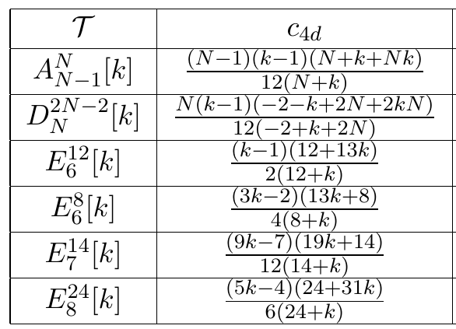
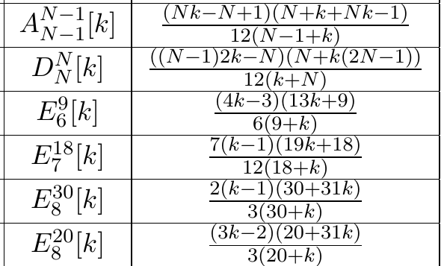
AD theories without flavor symmetry
AD theory $J^{b}[k]$
2d chiral algebra: diagonal coset model
$A=\frac{g_{l}⨁g_{1}}{g_{l+1}}$, with g=J, $l=−\frac{hk−b}{k}$
$c_{2d}=\frac{l\dim{J} }{l+h}+\frac{\dim{J} }{1+h}−\frac{\left(l+1\right)\dim{J} }{l+1+h}=−12c_{4d}$
h is dual Coexter number
Schur index = vacuum character

Slide 8
AD theories without flavor symmetry
AD theory $J^{b}[k]$
2d chiral algebra: diagonal coset model
$A=\frac{g_{l}⨁g_{1}}{g_{l+1}}$, with g=J, $l=−\frac{hk−b}{k}$
When b=h, $W^{J}[h+k,h]$ minimal model
Vacuum character = Schur index:
$$I=\frac{1}{\prod_{i=1}^{r}{(q^{d_{i}};q)}}PE[−\frac{q^{b+k}}{1−q^{b+k}}χ(q^{λ})]$$
$$PE\left[x\right]=exp⁡[\sum_{n=1}^{∞}{\frac{1}{n}x^{n}}]$$

Slide 9
AD theories without flavor symmetry: Example
$A_{N−1}^{N}\left[k\right]=(A_{N−1},A_{k−1})$
2d chiral algebra: W(k,k+N) minimal model
Schur index = vacuum character = $PE\left[\frac{\left(q−q^{k}\right)\left(q−q^{N}\right)}{{\left(1−q\right)}^{2}\left(1−q^{k+N}\right)}\right]=PE\left[\frac{\left(q^{2}+…+q^{N}\right)}{1−q}−…\right]$, with $PE\left[x\right]=exp⁡[\sum_{n=1}^{∞}{\frac{1}{n}x^{n}}]$
Symmetric under the exchange of k and N, two realization leads to the same SCFT
The theory has N-1 operators with E-R=2,…, N. $q^{2}$ represents the Stress tensor.
One can also read the relations between operators

Slide 10
AD theories with flavor symmetry
6d (2,0) ADE theory compactified on a sphere with irregular puncture and regular puncture
Irregular puncture: $Φ\sim \frac{T}{z^{2+k/b}}+…$
Regular puncture: Y
Classified by $(J^{b}\left[k\right], Y)$, J=ADE
$$× R^{3,1}$$

Slide 11
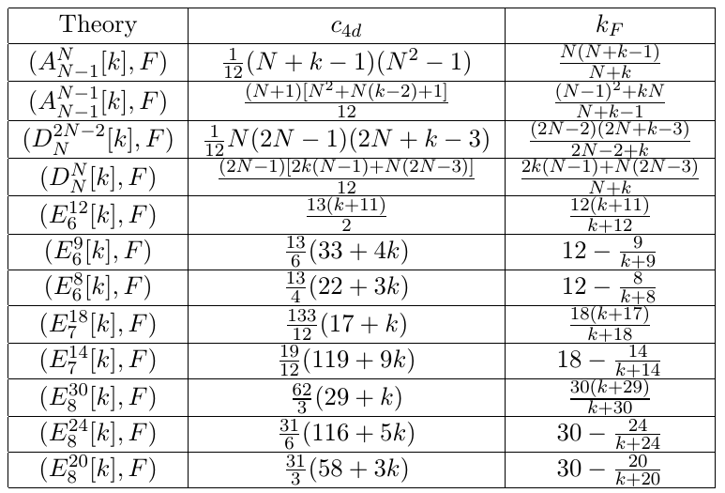
AD theories with flavor symmetry
Consider only full puncture F
Classified by $(J^{b}\left[k\right], F)$
Kac-Moody algebra $A_{−k_{F}}$
A=J, $c_{2d}=−\frac{k_{F}\dim{A}}{h−k_{F}}=−12 c_{4d}$
$k_{F}=h−\frac{b}{b+k}$
Schur index = vacuum character (Kac-Wakimoto)

Slide 12
AD theories with flavor symmetry
Classified by $(J^{b}\left[k\right], F)$
Kac-Moody algebra $A_{−k_{F}}$
A=J, $c_{2d}=−\frac{k_{F}\dim{A}}{h−k_{F}}=−12 c_{4d}$
At b=h, we have
$$I=PE[\frac{q−q^{b+k}}{(1−q)(1−q^{b+k})}χ_{adj}^{F} (z)]$$

Slide 13
AD theories with flavor symmetry: Examples
$A_{4}^{5}\left[−3\right]=D_{2}[SU\left(5\right)]$, Kac-Moody algebra is ${su(5)}_{−\frac{5}{2}}$
Schur index = $PE\left[\frac{q}{1−q^{2}}χ_{adj}^{SU\left(5\right)}\right]=PE[\frac{q\left(1−q+q^{2}−q^{3}+…\right)}{1−q}24+q^{2}−q^{2}]$
Higgs branch operators $O$ (moment maps) in adjoint (24) rep of SU(5); Stress tensor; etc
$O_{24+1}^{2}=0$ which is the Joseph relation of the Higgs branch
Structure of the Higgs branch is encoded in the Schur index
Direct obtain the Higgs branch from the chiral algebra

Slide 14
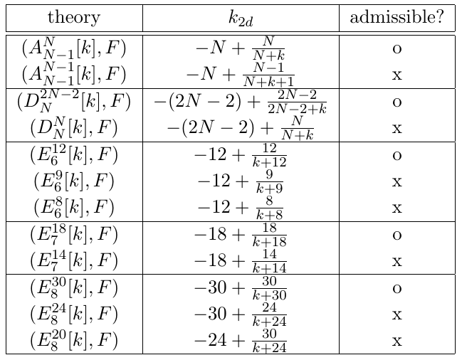
AD theories with flavor symmetry: Higgs branch
AD theory $\left(J^{b}\left[k\right], F\right),$Kac-Moody algebra $A_{−k_{F}}$
The Higgs branch is determined by the associated variety $X$ of th Kac-Moody algebra $A_{−k_{F}}$
For $k_{2d}=−h+\frac{p}{q}$, $p≥h$, associated variety $X$ is certain nilpotent orbit ${\overline{O}}_{q}$
Details see Arakawa[2015], Beem-Rastelli
In our case, for b=h, the Higgs branch is determined by the nilpotent orbit ${\overline{O}}_{q}$

Slide 15
AD theories with flavor symmetry: Higgs branch
$\left(J^{b}\left[k\right], F\right),$Kac-Moody algebra $A_{−k_{F}}$
For $k_{2d}=−h+\frac{p}{q}$, $p≥h$
$q<h$, nilpotent orbit is given by the table (Arakawa[2015])
$q≥h$, nilpotent orbit is just the principal nilpotent orbit ${\overline{O}}_{prin}$
$\left(J^{h}\left[k\right], F\right)$, $k=−h+\frac{h}{h+k}$
$k≥0$, all AD theories have the same Higgs branch
$$g$$ | $$q$$ | $${\overline{O}}_{q}$$
$${sl}_{n}$$ | any | $$\left(q,…,q,s\right), 0≤s≤q−1$$
$${so}_{2n}$$ | odd even | $$\left(q,…,q,s\right), 0≤s≤q,$$ $$s odd, number of q odd$$ $$\left(q,…,q,s,1\right), 0≤s≤q−1,$$ $$s odd, number of q even$$ $$\left(q+1,q,…,q,s\right), 0≤s≤q−1,$$ $$s odd, number of q even$$ $$\left(q+1,q,…,q,q−1,s,1\right), 0≤s≤q−1,$$ $$s odd, number of q even$$

Slide 16
AD theories with flavor symmetry: Higgs branch: Examples
$A_{4}^{5}\left[−3\right]=D_{2}[SU\left(5\right)]$, Kac-Moody algebra is ${SU(5)}_{−\frac{5}{2}}$, $k=−5+\frac{5}{2}, q=2$
Moment maps $O$ in adjoint (24) rep of SU(5)
$O_{24+1}^{2}=0$ which is the Joseph relation of the chiral ring of Higgs branch
The nilpotent orbit is given by (2,2,1)
2-instanton ADHM quiver for the gauge group SU(5)
2
5

Slide 17
AD theories with flavor symmetry: Higgs branch: Examples
$A_{4}^{5}\left[−1\right]$, Kac-Moody algebra is ${SU(5)}_{−\frac{15}{4}}$, $k=−5+\frac{5}{4}, q=4$
The nilpotent orbit is given by (4,1)
The Higgs branch of the above quiver gives the nilpotent orbit
1
2
3
5

Slide 18
Summary
Understand the BPS spectrum of AD theories using the index
Read off protected operators (current, Higgs branch operators…) and their relations
Compute the index: chiral algebra vs. TQFT
AD theories without flavor symmetry: diagonal coset model
AD theoires with flavor symmetry: Kac-Moody algebra
Higgs branch = associated varieties of Kac-Moody algebra

Slide 19
Future
Generalization
Arbitrary puncture: Drinfeld-Sokolov reduction
Twisted case: AD$⇒$BC
Beyond spectrum:
Correlation functions between BPS operators
Combining with bootstrap and more constraints on AD theories [LL15]
Thank you

Slide 20
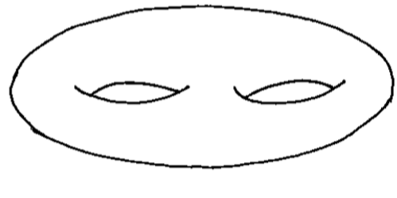
index and Topological Field theory
For class-S theories, indices enjoy a TQFT formulation [GPRR09, GRRY11, GRRY11, GRR12, etc]
6d (2,0) type-J theory compactified on a Riemann surface of genus g and s punctures
$I=\sum_{λ}{\frac{1}{{\left(\dim_{q}{λ}\right)}^{2g−2+s}}ψ_{1,λ}\left(q\right)ψ_{2,λ}\left(q\right)…ψ_{s,λ}(q)}$

Slide 21
index and Topological Field theory
For AD theories, similar formula [BN15, Song15]
$I=\sum_{λ}{\left(\dim_{q}{λ}\right)φ_{1,λ}\left(q\right)}$

Slide 22
Chiral Algebra VS Topological Field theory
Chiral algebra:
AD theories $⇒$ 2d chiral algebra
Index = vacuum character
TQFT:
Fix local contribution of each puncture to the index
Index = sum over representations
Complementary to each other. Consistency check. BPS spectrum

