Slide 1
6d Superconformal Field Theories
Cumrun Vafa
Harvard University
Tsinghua University
Strings 2016
August 4, 2016

Slide 2
The progress is based on works of many physicists from `early days':
Witten, Seiberg, Ganor, Strominger, Intriligator, Blum, Hanany, Zaffaroni, Karch, Brunner, Aspinwall, Morrison,…
As well as more recent years (past 3-4 years):
Aganagic, Beem, Bhardwaj, Bolognesi, Cordova, Dumitrescu, Gadde, Haghighat, Gaiotto, Hayashi, Heckman, Hohenegger, Intriligator, Iqbal, H-C Kim, S Kim, S-S Kim, Klemm, Koh, Kozcaz, Lemos, Lockhart, K Lee, S Lee, Morrison, Ohmori, D Park, J Park, Rastelli, Rey, Rudelius, Shimizu, Tachikawa, Taki, Taylor, Tomassiello, van Rees, Xie, Yagi, Yin, Yonekura and Del Zotto…

Slide 3
The plan for this talk is:
Motivation for 6d SCFT’s and their basic properties
(2,0) SCFT’s and ADE classification
(1,0) SCFT’s and their classification via F-theory
Anomaly polynomial and a-theorem
Properties of tensionless strings
Superconformal index
Extension to Little String Theories in 6d
Compactifications to lower dimensions
Future directions

Slide 4
Conformal Theories:
Proven to be important for a deeper understanding
of strongly coupled systems. Standalone quantum
systems.
Applications: Condensed matter physics
Particle physics
Quantum gravity via holography
Can we classify them?
Do they exist in arbitrary dimensions?

Slide 5
Difficult to prove existence and classification of
non-trivial CFT’s in higher dimensions.
However, the assumption of supersymmetry becomes
more powerful as we go up in dimension:
The highest dimension for a conformal field theory
which enjoys supersymmetry is 6 dimensions.
(related to the fact that conformal group is SO(6,2)
and triality of so(8) plays a key role for the existence
of superconformal algebra OSp(6,2|N)).

Slide 6
There are two types of superconformal theories in 6d
depending on the amount of supersymmetry:
N=(2,0) or (1,0) SCFT’s.
What we know:
1-They exist! (based on string theoretic arguments)
2-They involve tensionless strings as their basic
ingredients.
3-We have no Lagrangian formulation for any of them!
4-(2,0) case is classified by ADE.

Slide 7
5-The (1,0) case has also been classified recently in terms of generalized quivers—more intricate.
6-Many interesting CFT’s in lower dimensions can be obtained by compactifying these theories on manifolds of various dimensions.
Conjecturally all lower dimensional CFT’s can be obtained from these 6 dimensional theories. Moreover, in this way dualities of lower dimensional theories become geometric symmetries.

Slide 8
5-The (1,0) case has also been classified recently in terms of generalized quivers—more intricate.
6-Many interesting CFT’s in lower dimensions can be obtained by compactifying these theories on manifolds of various dimensions.
Conjecturally all lower dimensional CFT’s can be obtained from these 6 dimensional theories. Moreover, in this way dualities of lower dimensional theories become geometric symmetries.
6d SCFT's: Mother of all CFT's and dualities!

Slide 9
Basic algebraic results based on realization of unitary superconformal group [CDI]:
0- OSp(6,2|N) can be realized in QFT for N=1,2 only (existence of stress tensor).
1- The conformal fixed point has no moduli which preserves superconformal invariance.
2- To go away from conformal fixed points we can only give vev to fields— adding operators is not an option.
3- There are two ways to go away: Tensor branch
(analog of Coulomb branch in 4d) and Higgs branch.
4- (2,0) theory has SO(5) R-symmetry. No global symmetries.
5- (1,0) theory has SU(2) R-symmetry (which continues to hold on tensor branch). It can also have additional global symmetries.

Slide 10
The (2,0) Case
These are believed to be classified by ADE. The
simplest string construction involves the A-case:
The A-type (2,0) SCFT=
IR limit of the 6d-theory living on N-coincident
M5 branes. The CFT has no adjustable parameters
as expected.

Slide 11
There is a deformation away from the Conformal point:

Slide 12
Further evidence for their existence:
Holographic realization [M] via
More recent evidence based on bootstrap [BLRvR]:
The 2,3 pt function of energy momentum tensor are uniquely fixed by a known parameter c(ADE), which they find using bootstrap methods for the A1 case; strong direct evidence for the power of bootstrap methods to lead to an effective study of these models.

Slide 13
The D and E cases cannot be realized naturally in
M-theory. Type IIB is more powerful for this. The
IR limit of Type IIB on the singular locus:

Slide 14
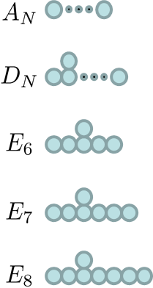
Blow up of ADE-singularity. The sizes of spheres
dual to scalar vevs.

Slide 15
Blow up of ADE-singularity: The sizes of spheres
dual to scalar vevs.
String: wrapped D3 brane

Slide 16
Using M-theory/type IIA/type IIB duality
M5--->NS5--->TN

Slide 17
Using M-theory/type IIA/type IIB duality
M2--->D2--->D3

Slide 18
(1,0) SCFT’s
These theories have half as much SUSY.
Classifiable!
Idea: Based on realization of them in F-theory.
Dual to M-theory constructions in some examples.
Elliptic 3-folds:

Slide 19
To gain insight, let us consider a few examples first:
M-theory: N M5 branes probing ADE singularity

Slide 20
To gain insight, let us consider a few examples first:
M-theory: N M5 branes probing ADE singularity

Slide 21
To gain insight, let us consider a few examples first:
M-theory: N M5 branes probing ADE singularity
F-theory:

Slide 22
To gain insight, let us consider a few examples first:
M-theory: N M5 branes probing ADE singularity
IIB/F-theory:

Slide 23
To gain insight, let us consider a few examples first:
M-theory: N M5 branes probing ADE singularity
F-theory:

Slide 24
Another example: M5 branes at the Hořava-Witten wall
F-theory:

Slide 25
This (1,0) theory:
O(-1) curve, unlike the O(-2) curve, when shrunk
leaves no imprint of singularity in the base.
122 corresponds to 3 blow ups of the base.
F-theory:

Slide 26
This (1,0) theory:
O(-1) curve, unlike the O(-2) curve, when shrunk
leaves no imprint of singularity in the base.
122 corresponds to 3 blow ups of the base.
F-theory:

Slide 27
F-theory:

Slide 28
F-theory:

Slide 29
Another class of examples [W]:
F-theory on orbifolds

Slide 30
Another class of examples [W]:
F-theory on orbifolds

Slide 31
Another class of examples [W]:
F-theory on orbifolds

Slide 32
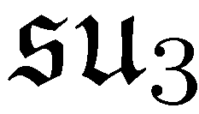
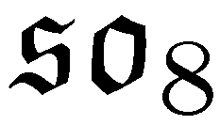
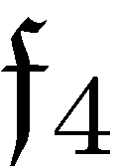
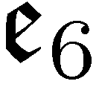
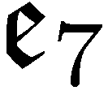
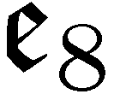

Slide 33
All the known examples of (2,0) and (1,0) CFT’s
can be realized in F-theory, which motivated:
Basic classification strategy [HMV,HMRV,B]-
Classify all the possible bases that can appear
in F-theory, up to blow ups
and adding 7-branes wrapping the cycles
(i.e. classify the maximally higgsed phase).
Surprising result: All allowed endpoints correspond
to orbifold singularities:
for special subgroups.

Slide 34
Each of these end points leads to a canonical
tensor branch (which require additional blow
ups for the elliptic 3-fold singularities) leading
to a final geometry of blow ups

Slide 35
M-theory interpretation: M5 branes probing
D,E singularities. For example:
M5

Slide 36
M-theory interpretation: M5 branes probing
D,E singularities. For example [DHTV]:
splits splits
M5

Slide 37
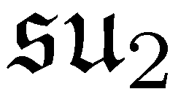
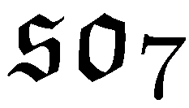
M-theory interpretation: M5 branes probing
D,E singularities. For example:
M5
bifundamental `E7 matter’ =SCFT

Slide 38
Emergence of repeating patterns
4 1 4 1 4 1 4
3 1 6 1 3 1 6
8 1 2 3 2 1 8
Notes:
38

Slide 39
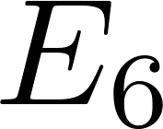
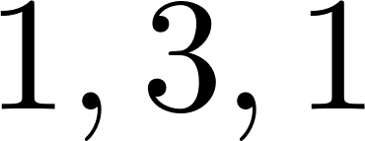
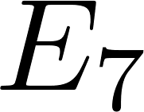
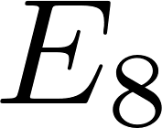
Notes:
39

Slide 40
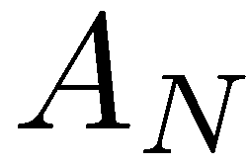
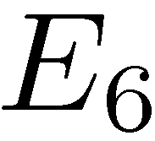
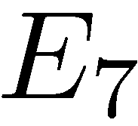
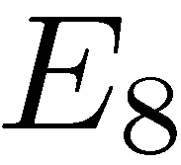
Building Blocks
n
3 2
2 3 2
3 2 2
Non-Higgsable Clusters [MT]
Notes:
40

Slide 41
The idea behind classification of 6d theories from
F-theory perspective:
The intersection structure of the curves (string
charge lattice) forms a positive definite quadratic
form: Kinetic term of the scalars is positive definite.
The diagonal structure is special and intersection
of nearby curves are also very special (dictated by
non-Higgsable clusters).

Slide 42
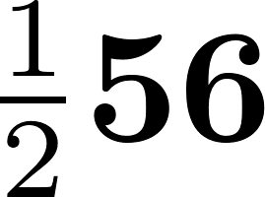
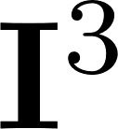
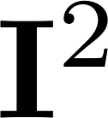
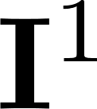
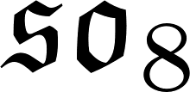
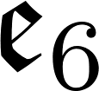
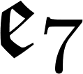
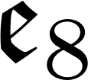
Notes:
42

Slide 43
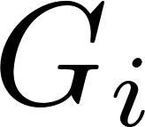
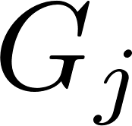
Notes:
43

Slide 44
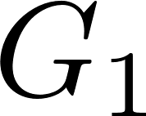
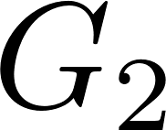
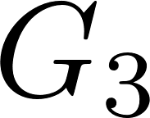
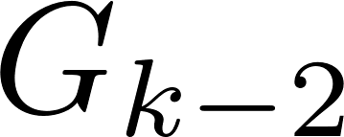
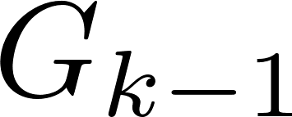
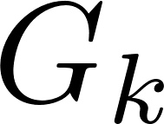
Notes:
44

Slide 45
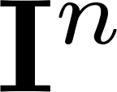
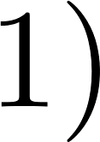
Notes:
45

Slide 46
Notes:
46

Slide 47
Dualities?
One may wonder whether any of the above theories
are dual to one another. Evidence was found [HMRV]
that there are no dualities among these theories extending the known fact for the (2,0) class to (1,0) case. An example:
12.1.2 1. 12. 1

Slide 48
Anomaly Polynomials
The 6d SCFT's are chiral and thus anomaly is an interesting aspect of them. Their coupling to gravity background and SU(2) R-symmetry will involve the 8-form anomaly polynomial:
The coefficients of the anomaly polynomial has been determined systematically [OSTY,I,CDI] for the quiver theories classified.

Slide 49
RG Flow and a-theorem in 6d
A generalization for an a-theorem has been proposed [C] which for even dimensions involves
It is believed that a>0 and decreases along RG-flow.
There is no proof of this in 6d, unlike in 2d, 4d.
For supersymmetric theories one can expect `a' to be related to anomaly polynomials (as in 2d, 4d).

Slide 50
Based on various consistency arguments it was proposed [CDI] that for SCFT's in 6d `a' can be computed from anomaly polynomials
Many checks were made that this indeed decreases along RG-flows [HR].

Slide 51
Tensionless Strings
Contrast with fundamental strings:
Fundamental Strings 6d strings
Tension: finite finite or zero
Coupling const. Yes No
Quantization Lorentz invariant ?

Slide 52
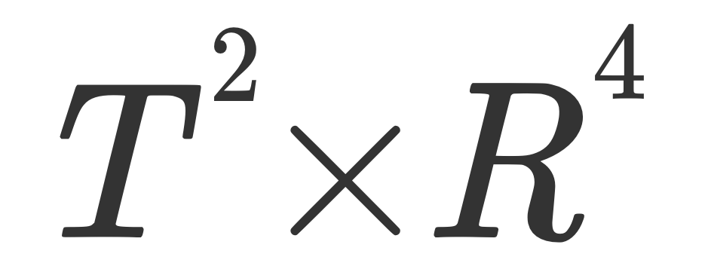
6d strings give rise to BPS states, and they enjoy (4,4)
(in (2,0) case) or (4,0) SUSY (in (1,0) case) on their
worldsheet.
One can ask what this 2d SUSY system is? It turns
out that string duality can be used to find what are
the IR degrees of freedom for such a string in many
cases, which can be used to compute SUSY partition
functions of it (and in particular on torus):
Moreover the elliptic genus of these strings can be
used to compute the superconformal index at the
CFT point [LV,I,KKK]:

Slide 53
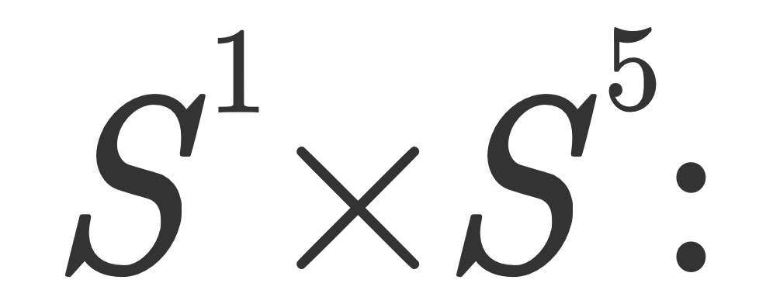
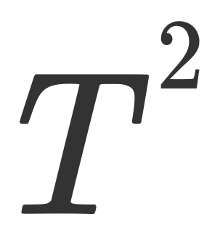

Slide 54
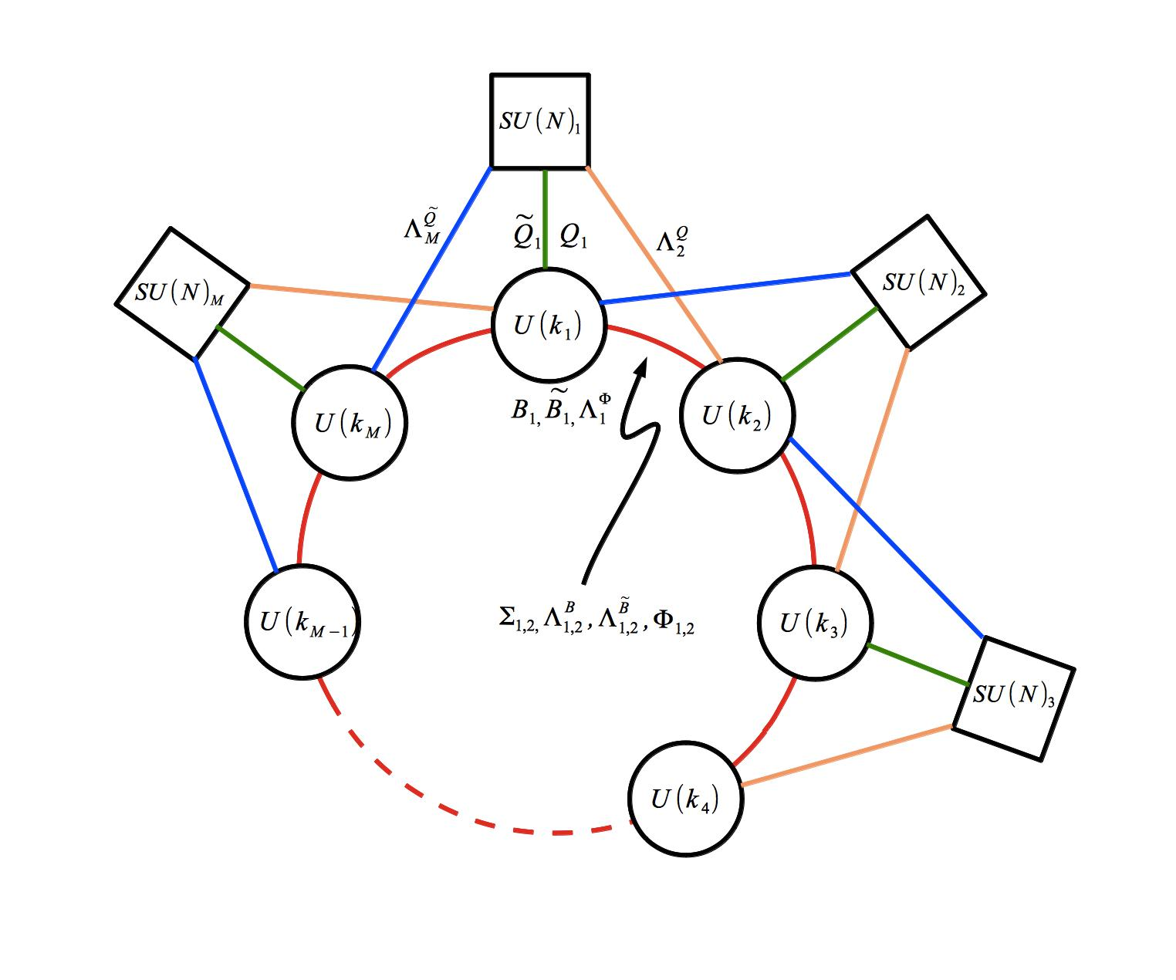
Examples:
The 2d (4,0) SUSY: quiver theory describing the
associated strings for the M5 branes probing A-type
Singularity [HKLV,HI].

Slide 55
For E-strings (the strings for the O(-1)
SCFT) the quiver for n E-strings is given by [KKKPV]
Note that the n=1 is the familiar way the E8 current
algebra arises in heterotic string

Slide 56
One learns unlike fundamental strings, tensionless
strings do form bound states which is reflected in the partition function of 2 strings on torus;

Slide 57
There are interesting probe strings for these theories which are classified by [DHPR]:
Where is the lattice of string charges. They correspond to D3 branes wrapping non-compact two cycles in the base of F-theory, whose charge cannot be screened by the dynamical strings. They can be viewed as surface operators of the CFT.

Slide 58
Extension to classification of ``Little String Theories’’
(see talks by Mina Aganagic and Tom Rudelius)
Little strings can be viewed as certain limits of string
theory where gravity decouples but fundamental
string does not [S]. So in particular they have a scale
and thus not conformal supersymmetric theories in
6d. The basic example in M-theory:
M5-branes whose transverse direction contains a
circle which we make arbitrarily small.

Slide 59
A More General Definition
LSTs are UV complete, non-local 6D theories with gravity decoupled and an intrinsic string scale
They are characterized by the presence of a non-dynamical tensor

Slide 60
Flows to CFT in the IR

Slide 64
[BDMRV]

Slide 65
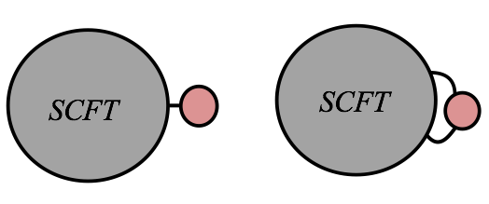
“Affinizing” SCFTs

Slide 66
Example: (2,0) LSTs
SCFTs
LSTs

Slide 67
A (1,0) Example
SCFT
LST

Slide 68
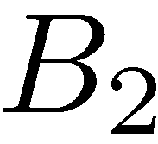
T-duality and LST’s
F-theory models of many LSTs feature a total space with two elliptic fibrations

Slide 69
In other words, the theories become equivalent upon
circle compactification—a hallmark of T-duality.

Slide 70
adjoint hyper
Other examples:
Affine A_k base with elliptic A_n singularity fiber
(base fiber exchange) is T-dual to k ↔ n
Note k=n is a self-T-dual LST.

Slide 71
Lower dimensional CFT's
We can compactify (1,0) and (2,0) SCFT's to lower dimensions on various manifolds and obtain new CFT's in IR
To 5d:
To 4d:
[G,GMN,AGT,BBBW; (2,0)]
[GR,OSTY,DVX; (1,0)]
To 3d:
[DGG,CCV,D]
To 2d:
[GGP]

Slide 72
Common Themes:
Dualities in lower dimensions are translated to geometric statement about cutting and pasting the internal manifold in different ways.
The amount of supersymmetry preserved can be adjusted by suitable choice of compactification geometry.
Sometimes one can get the same lower dimensional theory from two different higher dimensional theories.

Slide 73
A particular case: 6d→4d
Given the powerful classification of 6d SCFT’s it is
natural to ask what it teaches us about 4d SCFT's:

Slide 74
To preserve supersymmetry, we need to twist
(related to normal geometry of the 6d theory).
Equivalent to picking U(1) inside the R-symmetry
group and turning it on to lead to covariantly
constant spinors.
(2,0) theories: g= 1 → N=4 SCFT
General g →
U(1) sitting in SO(2) of SO(5) R-symmetry group
→ N=2 theories of class S [G]
U(1) sitting in SO(2)xSO(2) of SO(5)
→ N=1 theories [BBBW]
The IR theory leads to SCFT whose moduli is at least
that of the moduli space of Riemann surface.

Slide 75
For (1,0) theories:
The R-symmetry is SU(2) and thus the choice of
U(1) is fixed.
g=1 → N=2 theories in d=4
General g → N=1 theories in d=4
One may think that this always leads to theories
in the IR which are SCFT’s whose moduli at least
includes the moduli of Riemann surfaces.
Not so: e.g.
For example: O(-3) theory has no such limit.

Slide 76
Consider as a simple example the theory of N M5
branes probing G=ADE singularity. The resulting
6d (1,0) theory has GxG symmetry. It has been
argued [OSTY] that upon compactification
on T^2, if one turns off the GxG:
τ does not show up in the most obvious IR limit

Slide 77
A genus 0 Class S theory of G-type with 2 full
punctures +simple punctures

Slide 78
However, one can also consider compactifications of
(1,0) theories where the moduli of Riemann surface is
part of the 4d IR moduli space [DVX]. In fact for this
class since N M5 branes on T^2 is the same as N D3
branes in the IIB setup we get 4d affine ADE quivers
whose moduli is that of ADE flat connection on T^2.
For example for N M5 Branes probing E8 we get the
N=2 SU quiver theory:
3N
N 2N 3N 4N 5N 6N 4N 2N

Slide 79
More generally one can ask: Which 6d (1,0) theories lead to 4d theories where the moduli of Riemann Surface is part of the IR moduli of the CFT?
Answer [MV]: Those whose description involves in 6d ADE oribfolds can lead to 4d theories where the moduli space of Riemann surface will show up as moduli of 4d CFT.

Slide 80
For the (1,0) theory of N M5 branes probing ADE compactified on a more general Riemann surface:
Genus 0 leads to new N=1 theories which generically have no known Lagrangian formulation [GR].
Moduli space of genus g can involve the moduli space of a pair of flat ADE bundles on the Riemann surface (or an abelian subspace thereof) [RV].

Slide 81
Conclusions
I hope I have conveyed the rich structure of SCFT’s
in 6d. A lot has been done, but many significant
gaps remain.
- Complete the field theoretic reasoning for
classification (address some of the remaining issues).
- The algebraic meaning of the Dynkin-like diagrams
that emerge remains mysterious.
- Better understand the role of strings as excitations.
- Bootstrap methods need to be developed further
for a more effective study of these theories.
- Compactification to lower dimensions needs to be
studied further, especially for the (1,0) case.

