Slide 1


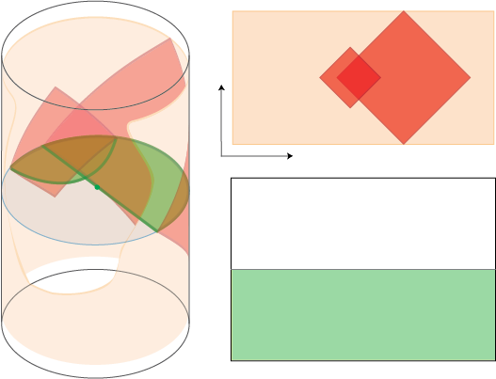
The Stereoscopic Holographic Dictionary
JAMES SULLY
B. Czech, L. Lamprou, S.McCandlish, B. Mosk, JS arXiv: 1604.03110
B. Czech, L. Lamprou, S.McCandlish, B. Mosk, JS arXiv: 160X.XXXX
(Related Work: de Boer, Haehl, Heller, Myers)
Strings 2016, Tsinghua University
August 2016

Slide 2
Motivation
There is an uncomfortable asymmetry in our use of the holographic dictionary:
  Boundary: Gauge-invariance is sacrosanct.
  We always use gauge-invariant observables to probe the bulk and vice-versa.
  Bulk: Diff-invariance is required…
  When we visit an expert twice a year, we acknowledge the importance of diff-invariance.
  We really only worry about it once a month or so.
Worrying about diff-invariance is largely seen as adding unpleasant (and unnecessary) complications
So, instead, we just work with the ‘local’ effective operators.
in the same way that flossing is required.

Slide 3
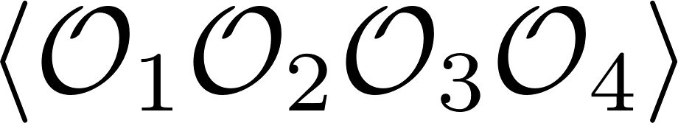
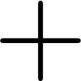


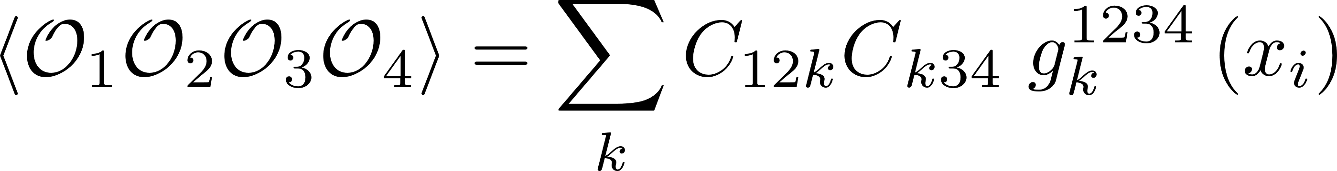
What has locality done for us lately?
Using these non-invariant effective observables is meant to be an easier way to do bulk calculations:
Gravity:
hard integrals …
CFT:
How do we compare?
Dynamical Parameters
Conformal Kinematics: All integrals hidden here!

Slide 4

Standard picture is much easier?
Not really....
… then, are diff-invariant (non-local) variables really that bad?
Aim of this talk: NO.
Questions:
What is an improved gauge/gravity dictionary that is gauge-invariant on one side and manifestly diff-invariant on the other?
Can we find a better connection to the natural CFT variables that make the OPE so simple?
Answer:
Stereoscopic Dictionary:
Surface Operators in AdS
(Non-local, diff-invariant)
$$↔$$
Partial Waves of the OPE
(building blocks of the OPE)

Slide 5
The Kinematic Dictionary
This will be a powerful framework. It brings together many familiar ideas in holography, including:
  The Entanglement First Law and Einstein’s Equations [Faulkner, Guica, Hartman, Lashkari, McDermont, Myers, Swingle, Van Raamsdonk]
  Geodesic Witten diagrams and conformal blocks [Hijano, Kraus, Perlmutter, Snively]
  The HKLL construction of interacting ‘local’ bulk fields [Hamilton, Kabat, Lifschytz, Lowe; Kabat, Lifschytz]
  de Sitter dynamics for the variations of EE [de Boer, Heller, Myers, Neiman]
  [Nozaki, Numasawa, Prudenziati, Takayanagi], [Bhattacharya, Takayanagi]

Slide 6
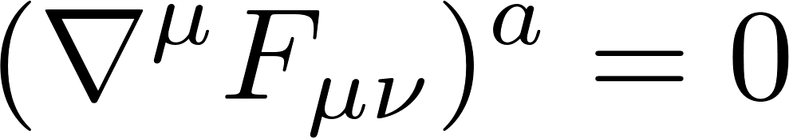
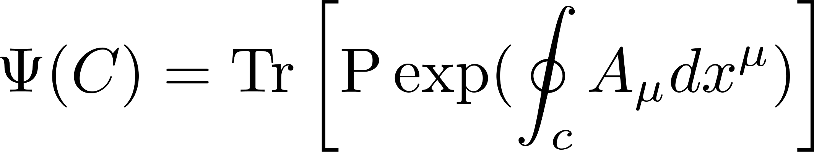
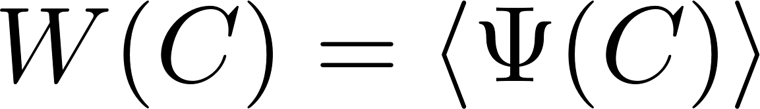
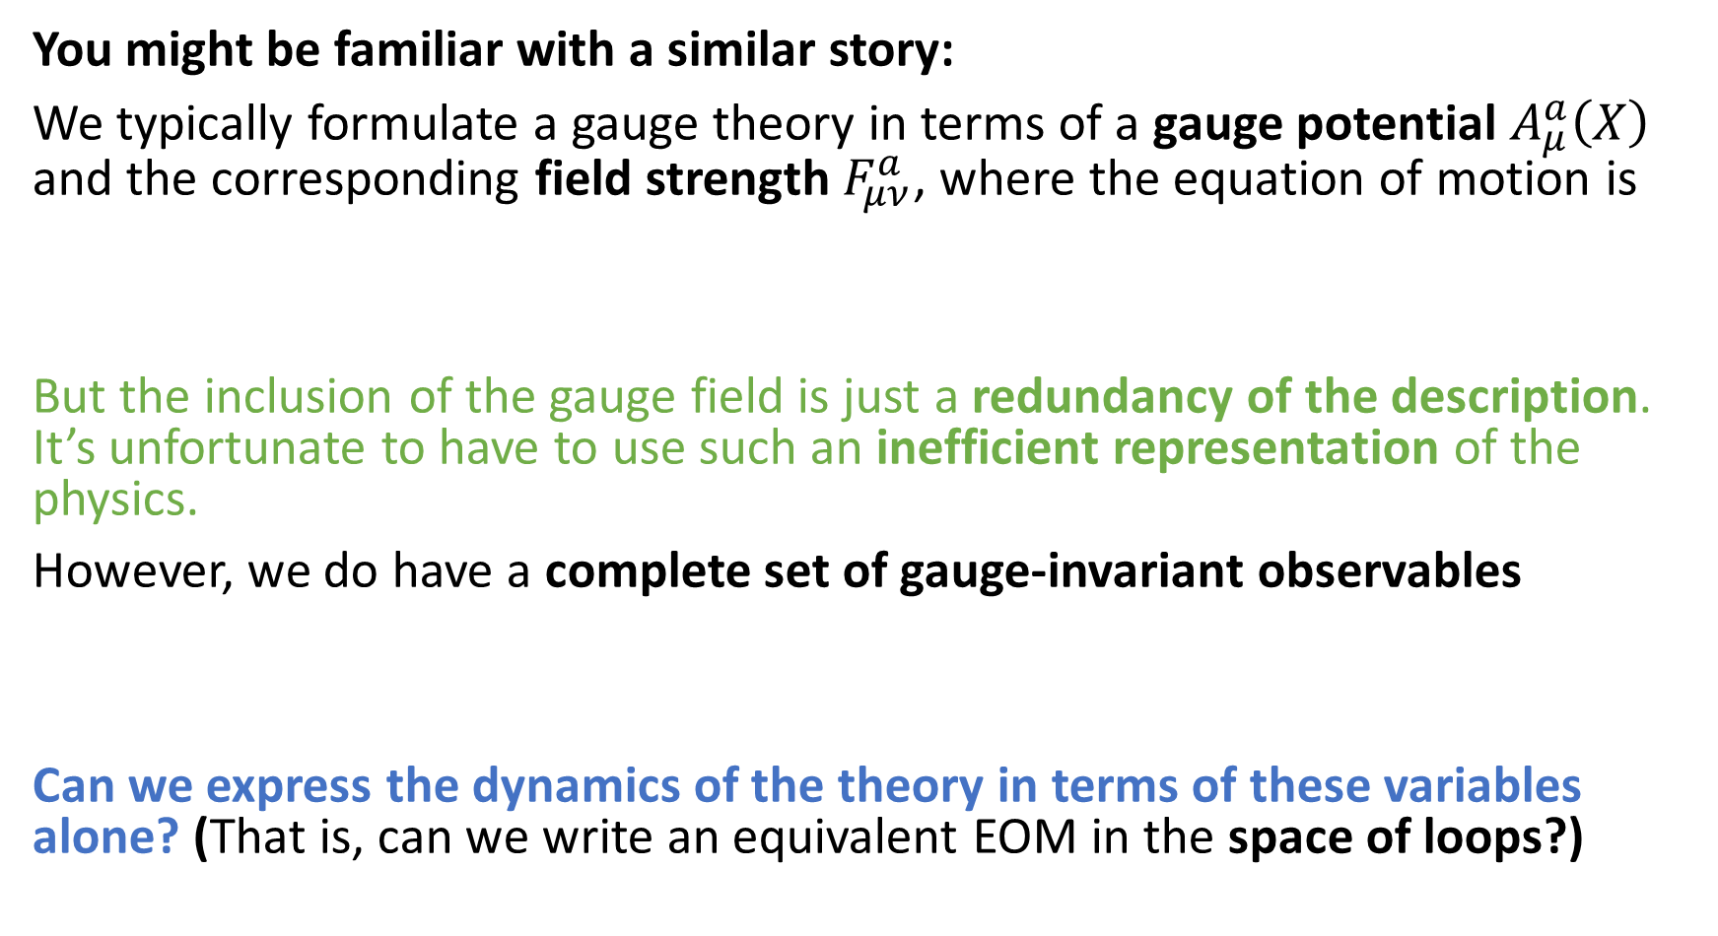
Lesson from gauge theories
You might be familiar with a similar story:
We typically formulate a gauge theory in terms of a gauge potential $A_{μ}^{a}\left(X\right)$ and the corresponding field strength $F_{μν}^{a}$, where the equation of motion is
But the inclusion of the gauge field is just a redundancy of the description. It’s unfortunate to have to use such an inefficient representation of the physics.
However, we do have a complete set of gauge-invariant observables
Can we express the dynamics of the theory in terms of these variables alone? (That is, can we write an equivalent EOM in the space of loops?)

Slide 7
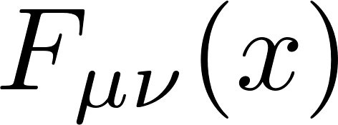
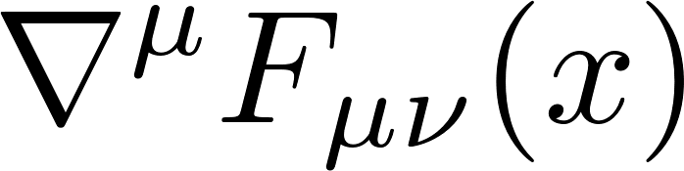



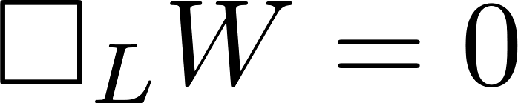
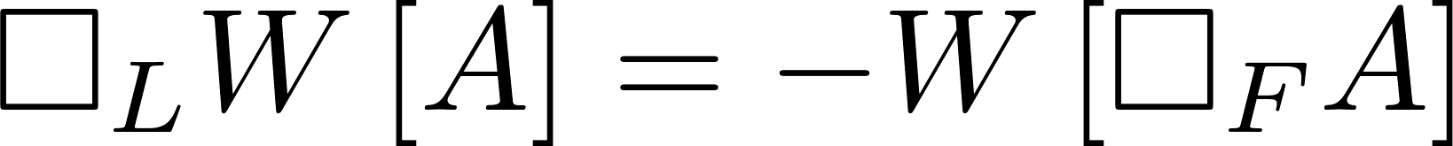

Loops
[Migdal, Makeenko; Polyakov; Halpern, Makeenko;…]
How do we insert the equation of motion into a Wilson loop?
Can also define a field space Laplacian $□_{F}$, and view Wilson loop as a ‘loop transform’ $W$ of the gauge field. At large N:
Loop Equation: (Classically)
Intertwining Operators

Slide 8
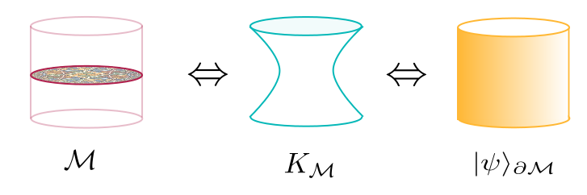
Requirements for a new language
The loop equations are analogous to the organization of gravitational physics we have been looking for.
We might re-express our search for the correct language:
What is the right loop space for gravity?
What are the loop operators and their loop equations for bulk physics?
What do the loop equations and loop operators look like in the gauge theory?
$$⇔$$
Loop Space

Slide 9

Loop Space = ?
We need to understand: what is the right loop space for gravitational physics in AdS/CFT?
Thankfully an example of the type of construction we’re searching for has already been found: Ryu-Takayanagi Proposal.
The Ryu-Takayanagi (RT/HRT) proposal connects:
S
$$A$$
The entanglement entropy of a region A on the boundary.
The area of a minimal surface S in the gravitational dual

Slide 10
Integral Geometry
What is the lesson from Ryu-Takayanagi?
The CFT sees the bulk geometry naturally through codimension-2 minimal surfaces.
  Boundary conditions are codimension-2 surfaces on the CFT cylinder
One could define the relevant loop space to be all possible spacelike surfaces.
  Probably enormously redundant: infinite-dimensional space
Let’s define our loop space to be the space of minimal surfaces with spherical boundary conditions (in any frame)
We will give it a new name: Kinematic Space
  Familiar object of study for some mathematicians: it is a primary object in the field of integral geometry.

Slide 11


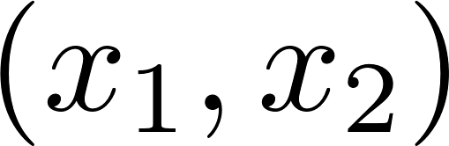

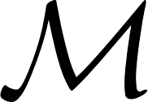
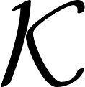
Kinematic Space
What does kinematic space look like?
Consider an ordered pair of timelike separated points on the boundary:
G
Boundary
Bulk
Kinematic Space

Slide 12
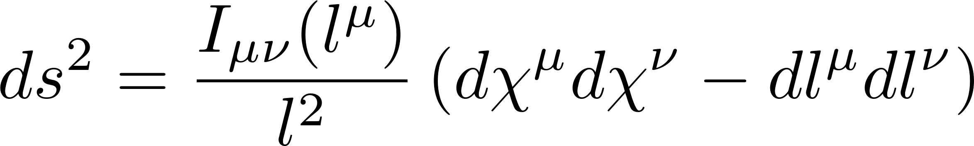
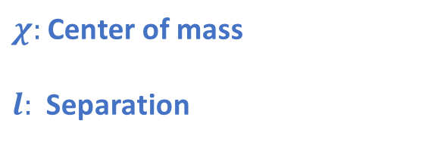
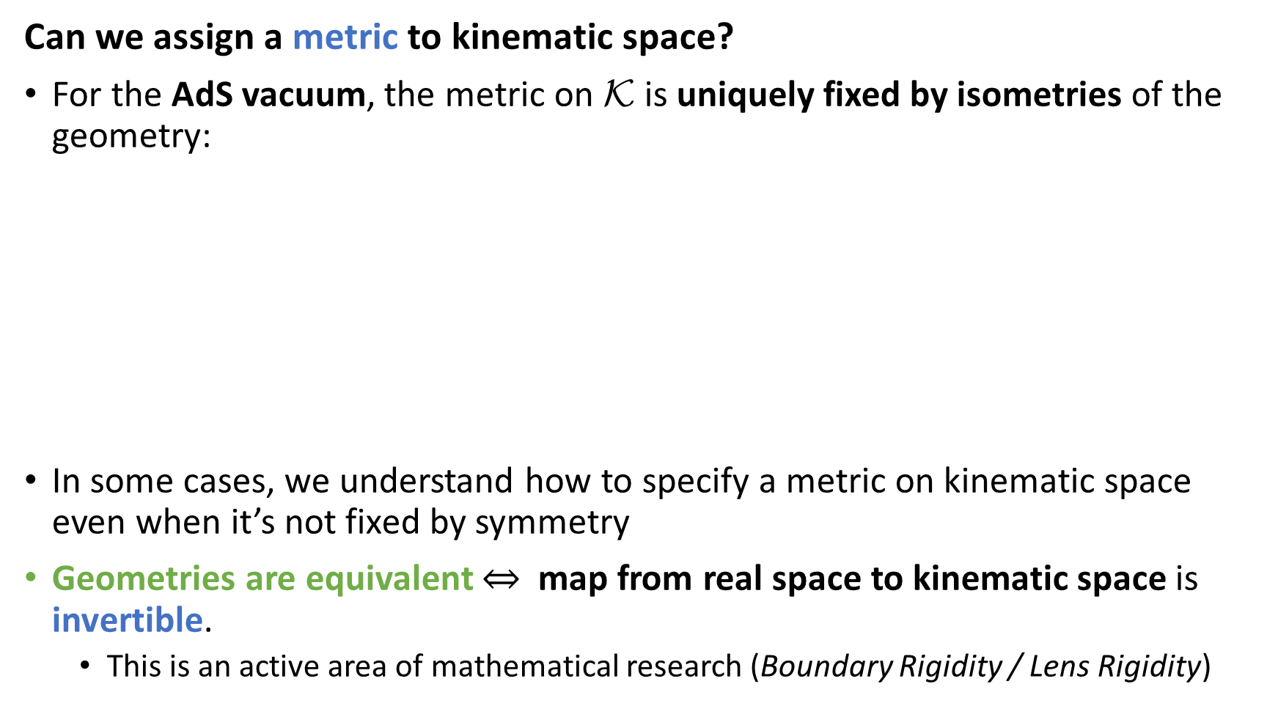
Kinematic Space
Can we assign a metric to kinematic space?
For the AdS vacuum, the metric on $\text{K}$ is uniquely fixed by isometries of the geometry:
In some cases, we understand how to specify a metric on kinematic space even when it’s not fixed by symmetry
Geometries are equivalent $⇔$map from real space to kinematic space is invertible.
  This is an active area of mathematical research (Boundary Rigidity / Lens Rigidity)
$χ:$ Center of mass
$l:$ Separation
Signature: (d,d)

Slide 13
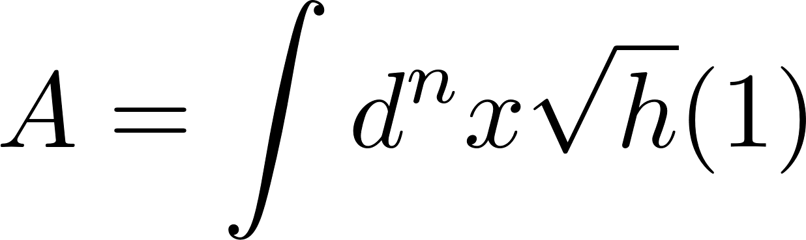

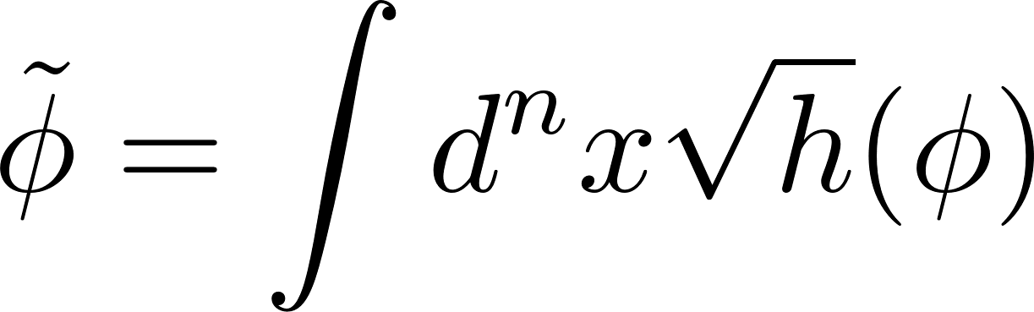


Kinematic Fields
We want to generalize the Ryu-Takayanagi example to describe all of the bulk physics. We also need the right ‘Wilson Loops’ in addition to the right space.
We can think of their areas as integrating the unit operator over the minimal surface:
A natural generalization then is:
This bulk surface/geodesic operator is a non-local and diff-invariant bulk probe.
Radon Transform: $R\left[φ\right]≔\tilde{φ }$

Slide 14
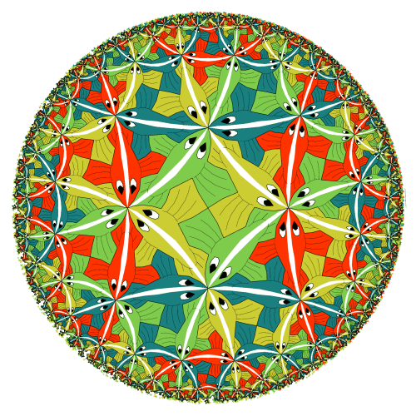
Radon Transform
The Radon transform has nice properties under isometries of the geometry:
_
_
$$f(x)$$
$$K$$
$$M$$
_
_
_
_
_
_
$$f(x)$$
$$f(x)$$
$$f(x)$$
“Intertwining Operators”

Slide 15
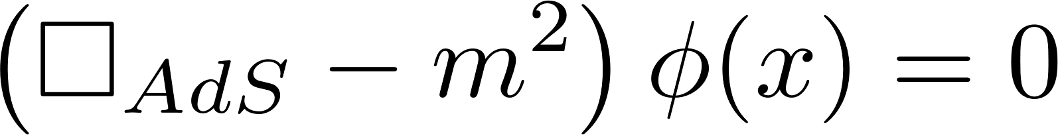
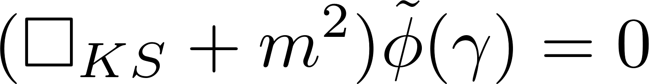
Loop Equations in kinematic space
Intertwinement allows us to rewrite the dynamics of the gravitational theory in terms of dynamics on kinematic space:
Free Scalar Field:
Loop EOM for free scalar
= Kinematic Free scalar EOM

Slide 16
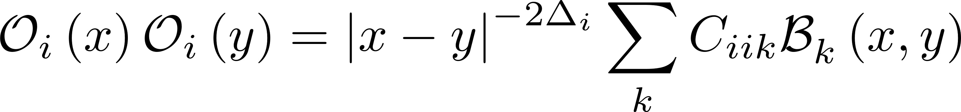
The Operator Product Expansion
We’ve found a natural set of gravitational variables that are non-local, and that contain the information normally specified using local ‘differential’ description.
We haven’t succeeded unless these appear naturally in the dual gauge theory:
Consider a quasi-primary operator ${\text{O}}_{i}\left(x\right)$of dimensions $Δ_{i}$. We can expand the product of two such operators using a local basis of operators:
Let us introduce a more compact notation for this expansion
We will call ${\text{B}}_{k}^{}\left(x,y\right)$ the ‘OPE Block’
$${\text{O}}_{i}\left(x\right)$$
${\text{O}}_{i}(0)$
Dynamical Parameters
Conformal Kinematics

Slide 17
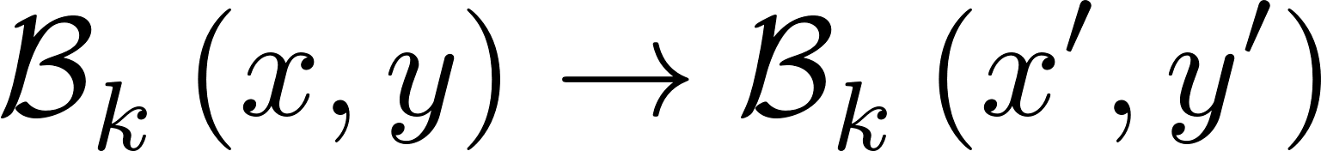
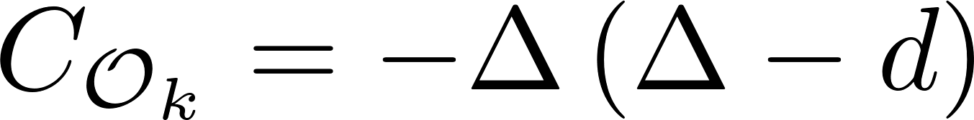
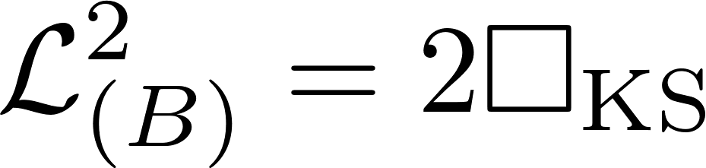
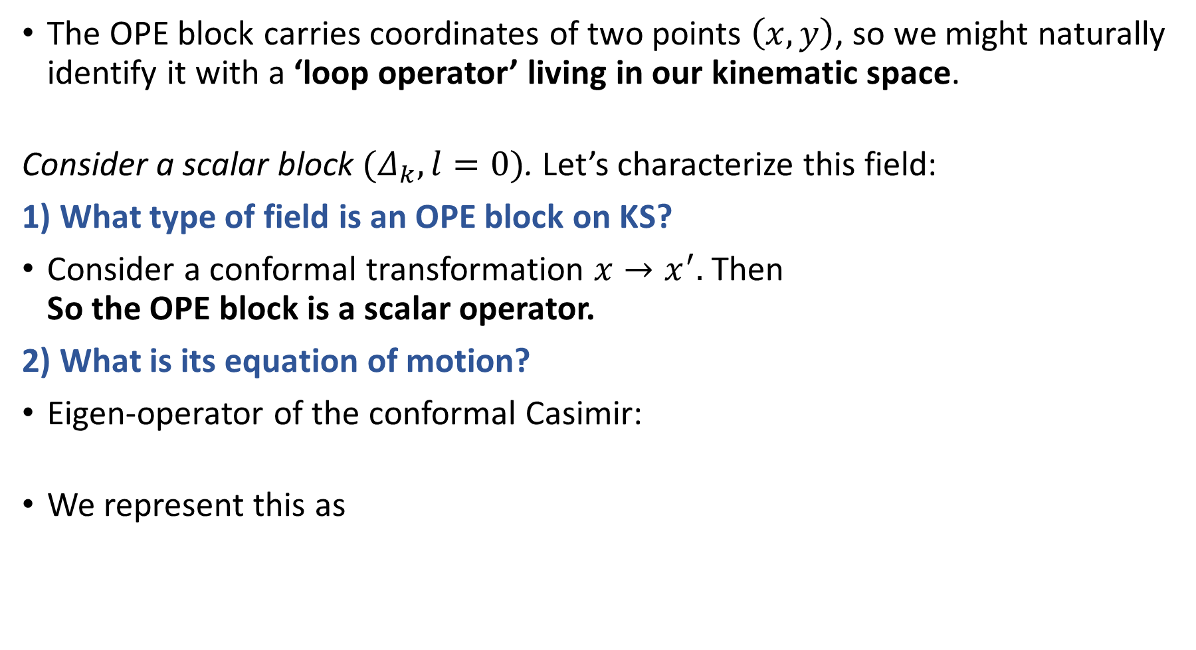
OPE Blocks as Kinematic Fields
The OPE block carries coordinates of two points $\left(x,y\right)$, so we might naturally identify it with a ‘loop operator’ living in our kinematic space.
Consider a scalar block $(Δ_{k},l=0)$. Let’s characterize this field:
1) What type of field is an OPE block on KS?
Consider a conformal transformation $x→x^{′}.$Then
So the OPE block is a scalar operator.
2) What is its equation of motion?
Eigen-operator of the conformal Casimir:
We represent this as

Slide 18
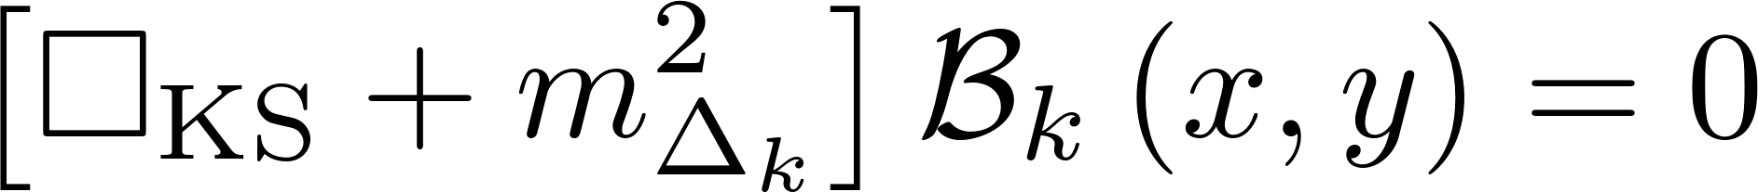
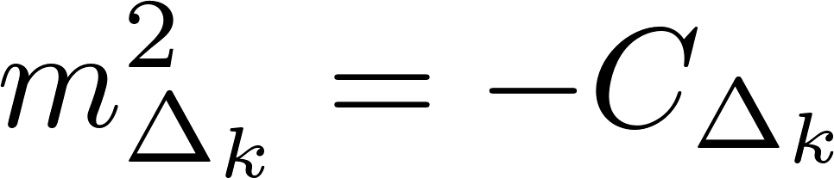
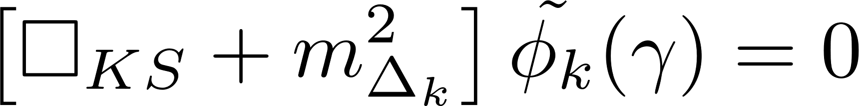
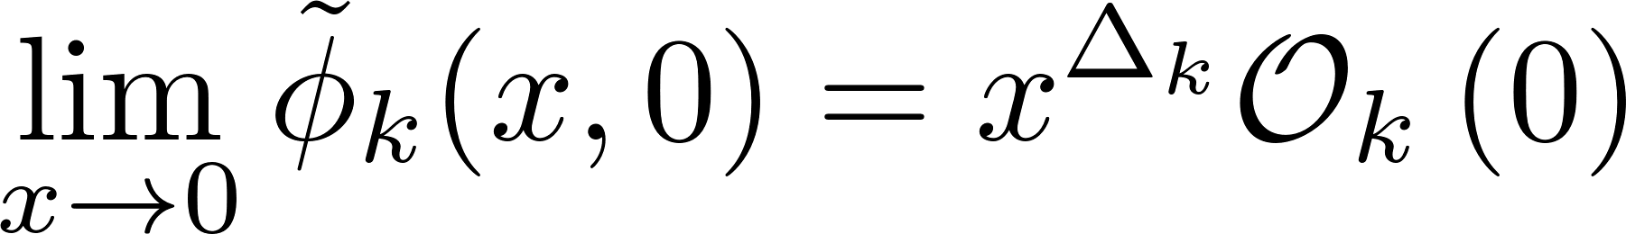
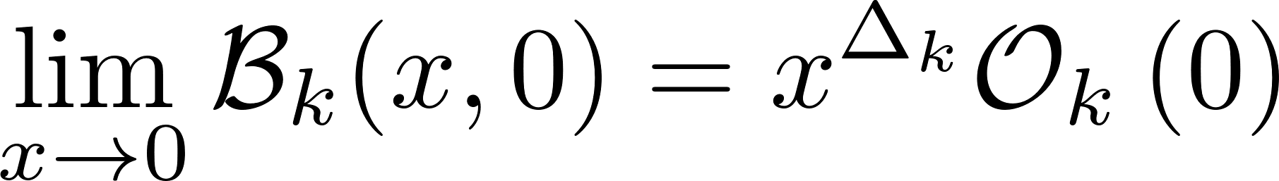

OPE Blocks as Kinematic Fields
We thus find an equation of motion for the OPE block
It is the same wave equation obeyed by a bulk geodesic operator dual to the operator $𝓞_{k}$:
 | Gravity | CFT
EOM
BCs
Constraint
‘John’s Equations’
‘Spin’
*Generic theory on KS has infinite tower of spins…

Slide 19


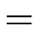
The Kinematic Dictionary
We have now established a new organization of the holographic dictionary
between OPE Blocks and geodesic operators (and extensions to surface operators).

Slide 20
Requirements for a new language
We might re-express our search for the correct language:
What is the right loop space for gravity?
  A: Kinematic space of minimal surfaces
What are the loop operators and their loop equations for bulk physics?
  A: Surface operators. Their loop equations take the form of simple equations of motion in kinematic space.
What do the loop equations and loop operators look like in the gauge theory?
  A: The gauge theory sees the loops equations through the decomposition of the operator product expansion.

Slide 21




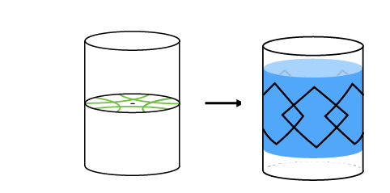
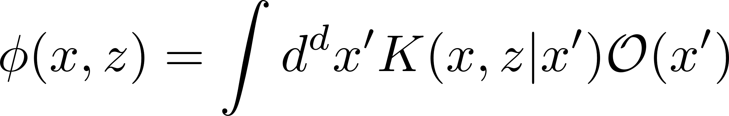
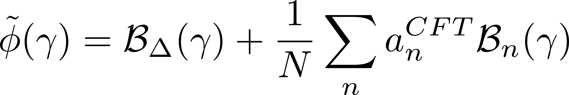
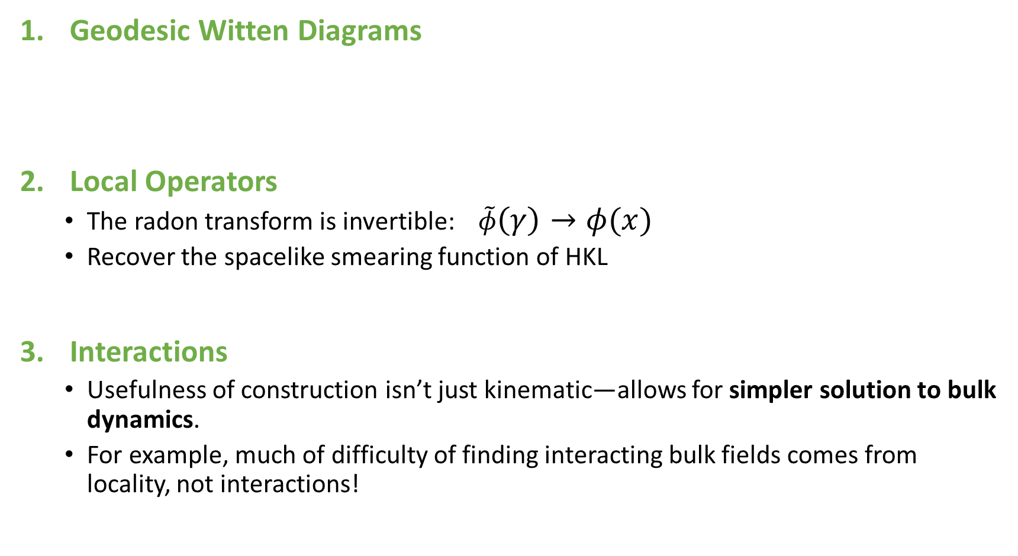
Some Applications (see paper for details)
Geodesic Witten Diagrams
Local Operators
  The radon transform is invertible: $\tilde{φ}\left(γ\right)→φ(x)$
  Recover the spacelike smearing function of HKL
Interactions
  Usefulness of construction isn’t just kinematic—allows for simpler solution to bulk dynamics.
  For example, much of difficulty of finding interacting bulk fields comes from locality, not interactions!
[Hijano, Kraus,
Perlmutter, Snively]
[Hamilton, Kabat,
Lifschytz, Lowe]
[Kabat,
Lifschytz]

Slide 22
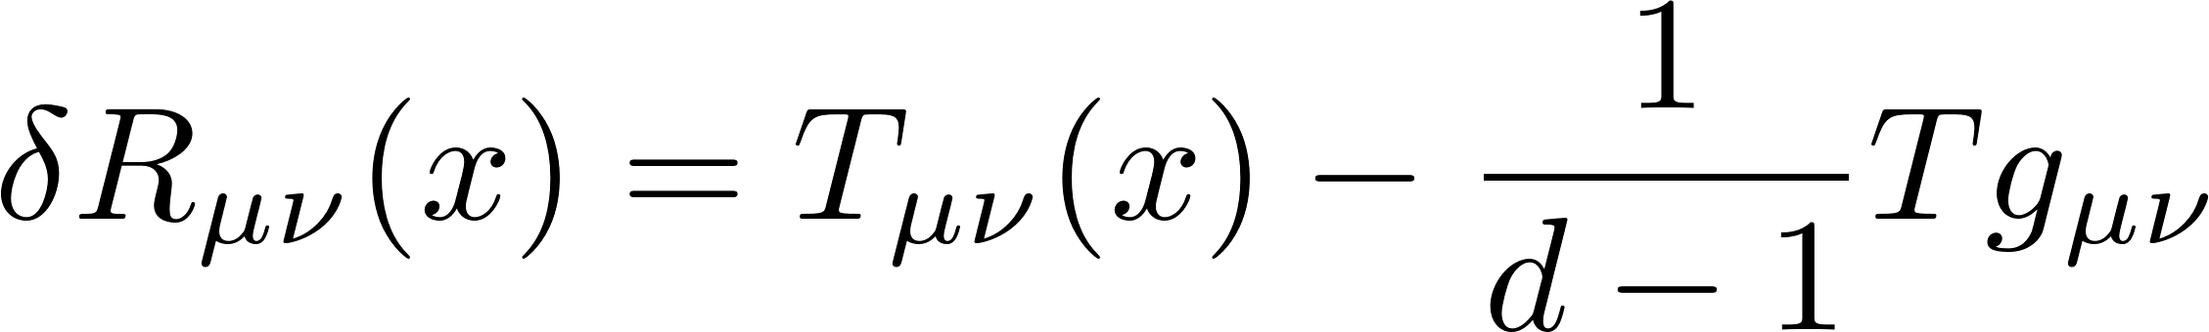
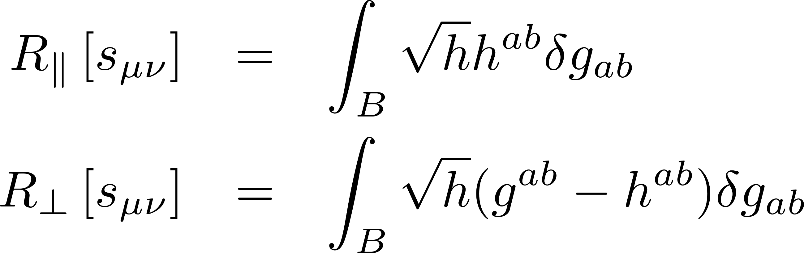
4) Linearized Einstein Equations
We have the linearized EOM:
Can define Radon Transforms:
and prove an analogous intertwining relation:
We find the Kinematic version of the EOM:
Cf. [de Boer, Heller, Myers, Neiman]
[Nozaki, Numasawa, Prudenziati, Takayanagi], [Bhattacharya, Takayanagi]

Slide 23
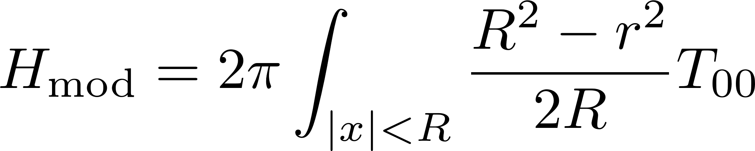
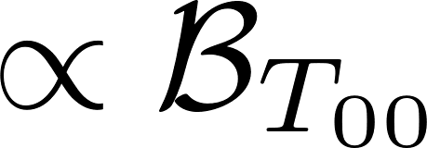
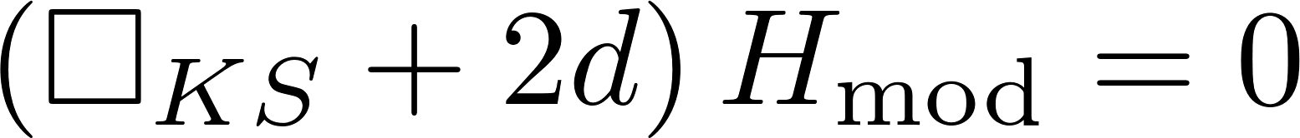
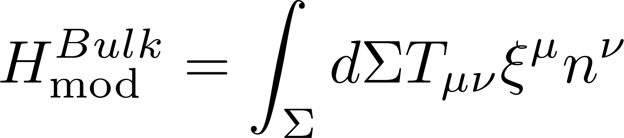
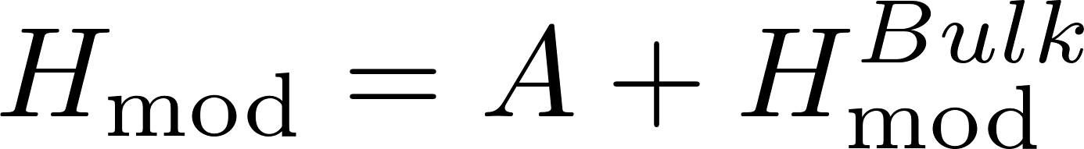
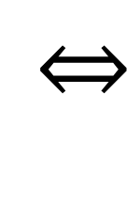


Cf. [Faulkner, Guica, Hartman, Lashkari, McDermont, Myers, Swingle, Van Raamsdonk]
What about the CFT?
Casimir Eqn:
Using the 1/N expansion
Then for a perturbation around the vacuum:
Read in the opposite direction, this is a derivation of the bulk expression for $H_{mod}$
$H_{mod}$ is just an OPE Block!

Slide 24
Summary
We found a set of non-local, gauge-invariant building blocks both in the bulk and on the boundary to build a ‘better’ holographic dictionary.
On the boundary: OPE blocks
In the bulk: Geodesic/Surface Operators
Finding the right kinematic variables isn’t just kinematics:
Our improved dictionary simplifies many dynamical bulk calculations.
Where next?
Must extend formalism away from small perturbations about vacuum.

