Slide 11
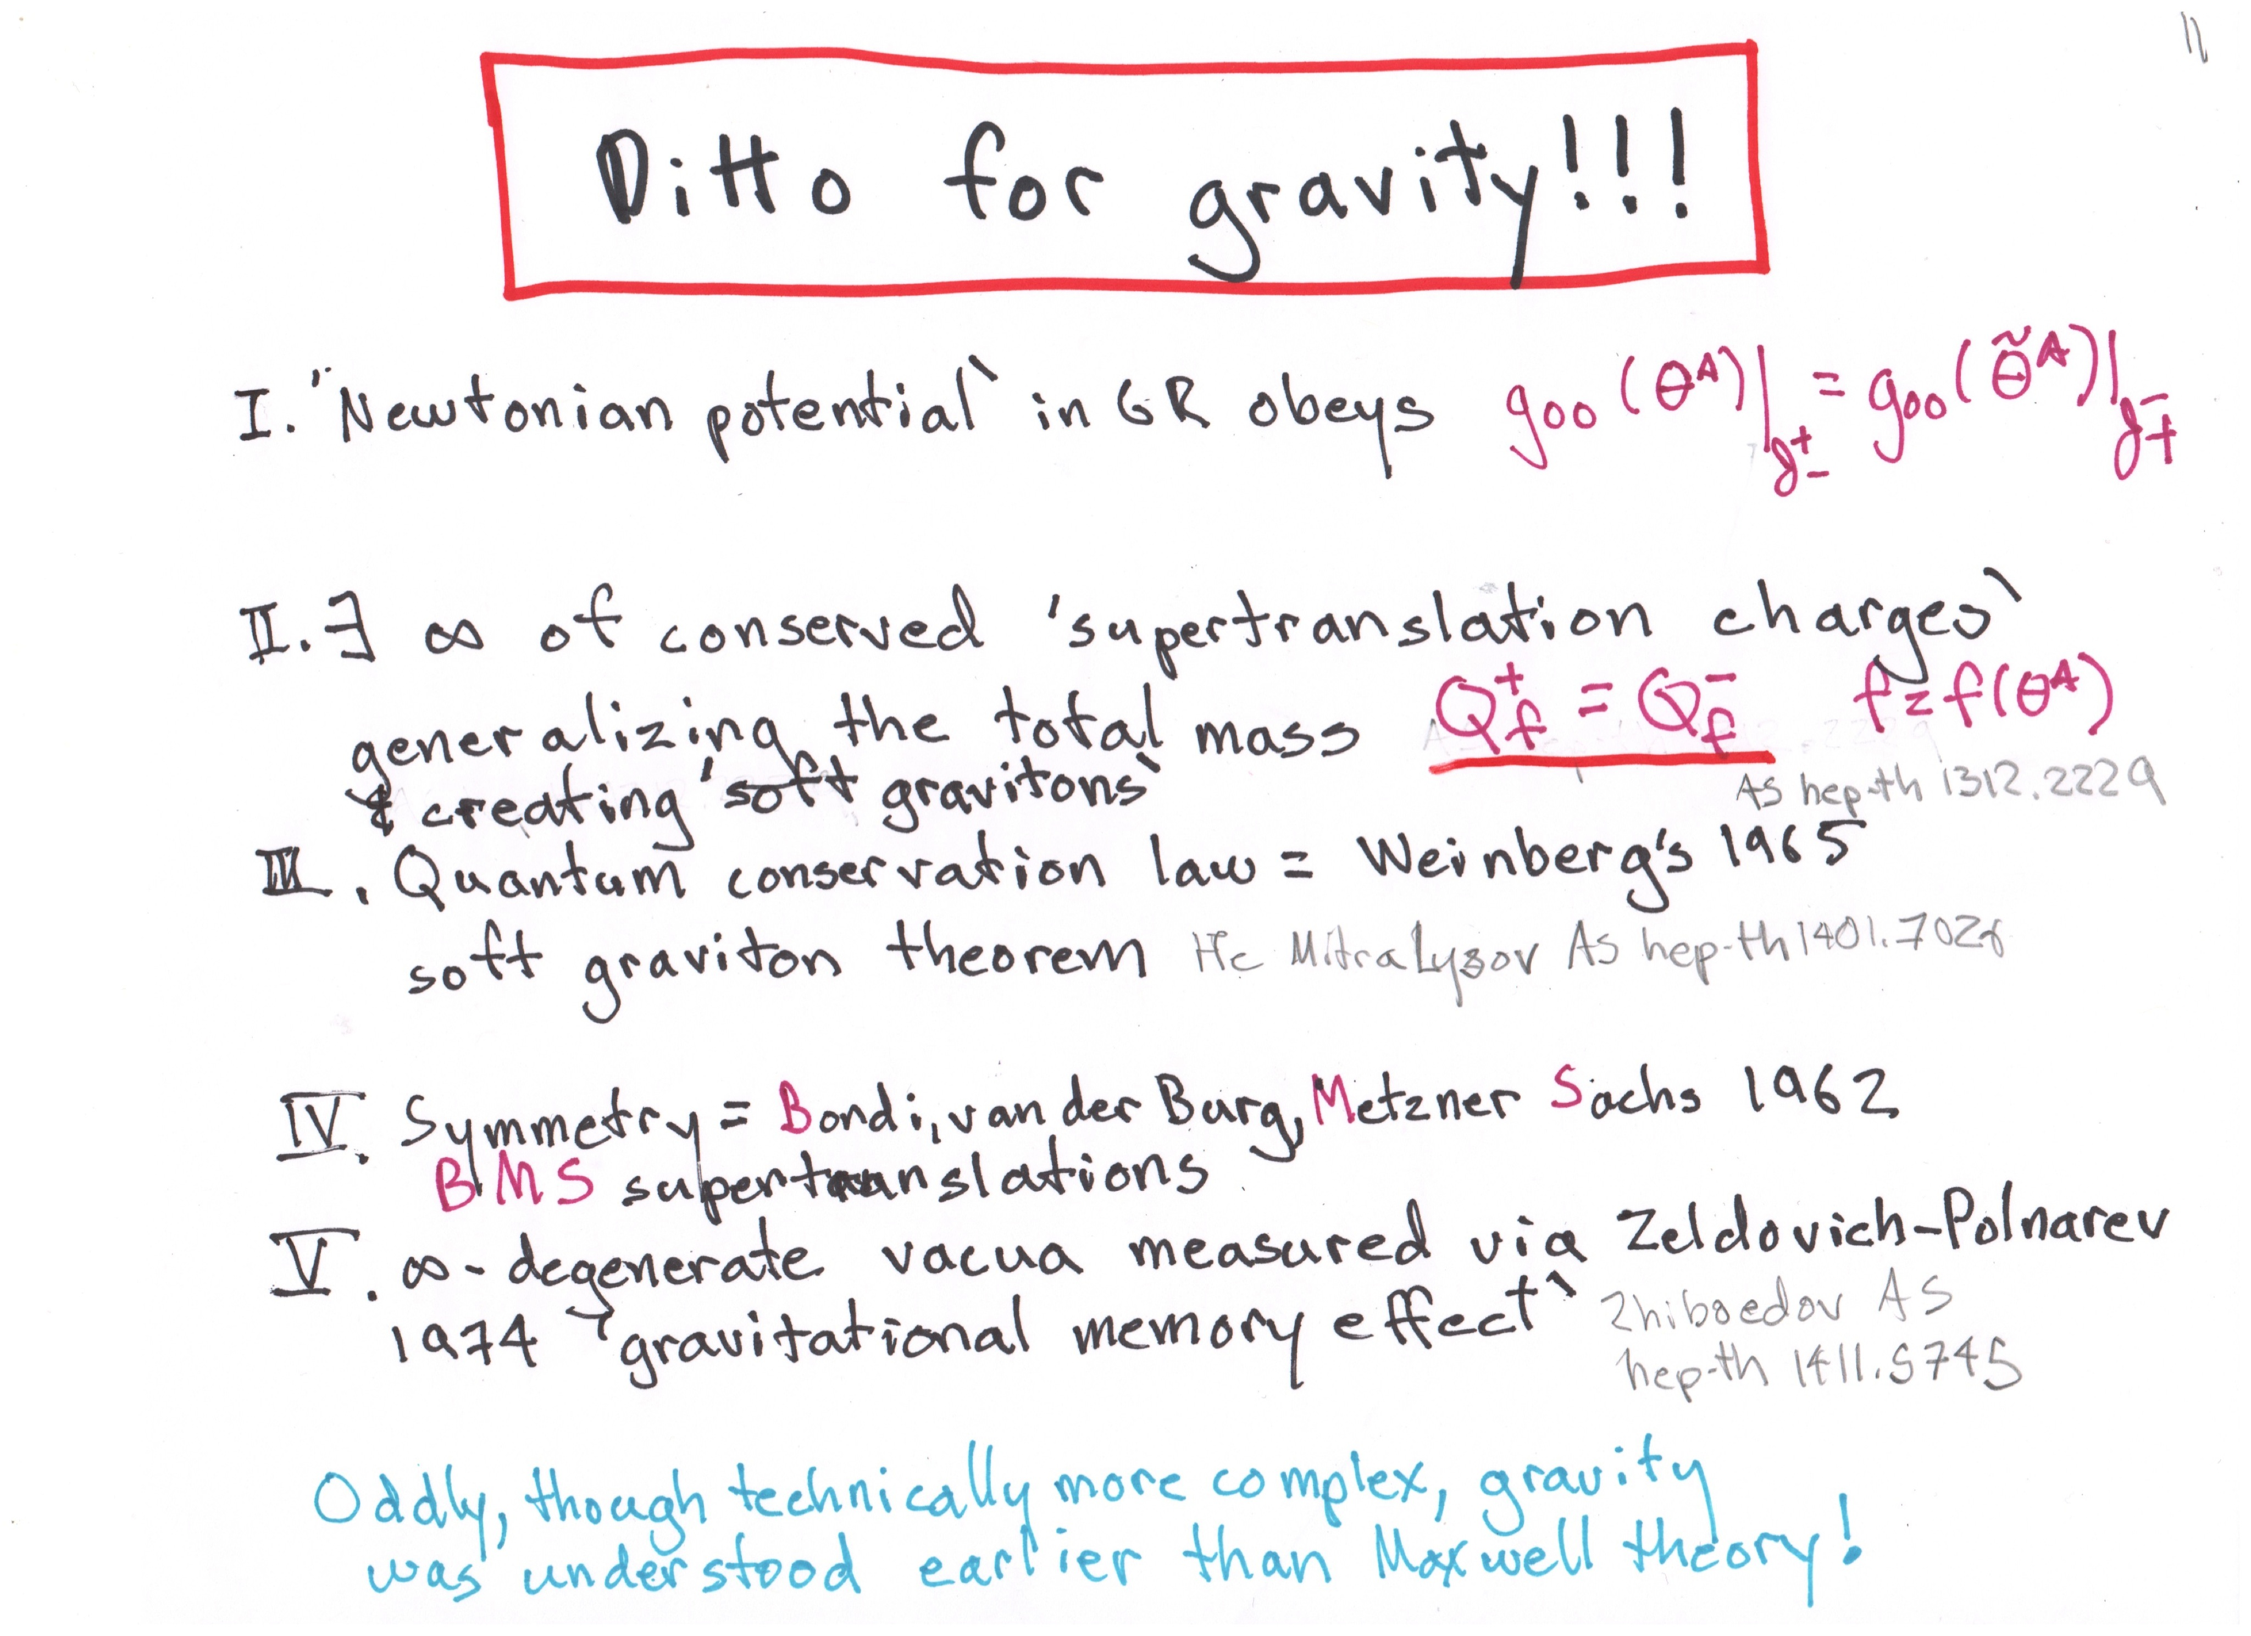

Slide 13
SOMETHING
NOW
THERE
IS
SOFT HAIR

