Slide 1


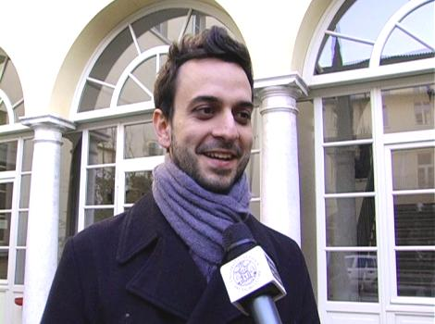
Effective Field Theory of Dissipative Fluids
Hong Liu
Paolo Glorioso
Michael Crossley
arXiv: 1511.03646
and to appear

Slide 2
Conserved quantities and hydrodynamics
Consider long wavelength disturbances of a system in thermal equilibrium:
non-conserved quantities: relax locally,
conserved quantities: cannot relax locally, only via transports
Gapless and long-lived modes
(only ones in thermal equilibrium)
Conserved quantities
There should exist a universal low energy effective theory.
Phenomenological description:
Hydrodynamics
slowly varying functions of spacetime

Slide 3

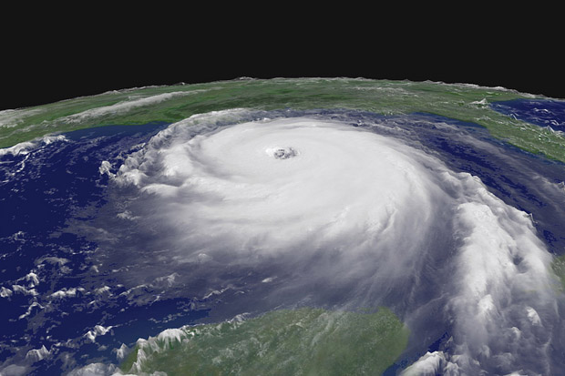

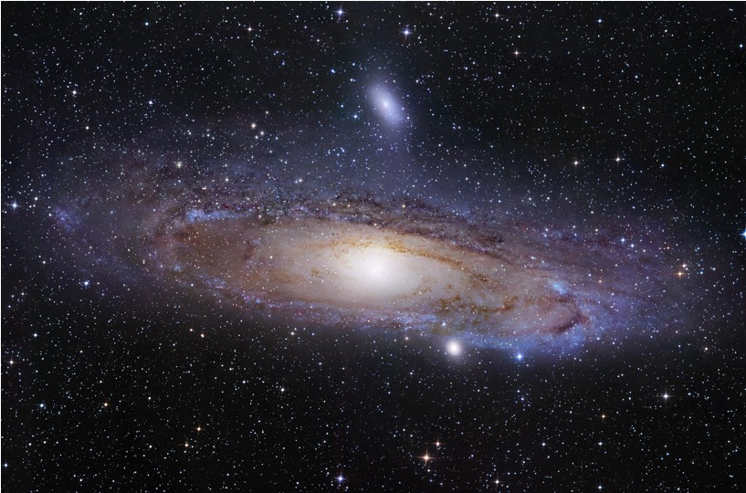

Slide 4
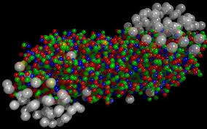

O’Hara et al (2002)

Slide 5
Despite the long and glorious history of hydrodynamics
It does not capture fluctuations, which are always present, and
are important in many physical contexts:
Transports (long time tail), dynamical aspects of phase transitions,
non-equilibrium steady states, turbulence, finite size systems
….......
Phenomenological level: stochastic hydro (Landau, Lifshitz)
Good for near-equilibrium disturbances (linearized)
But not adequate for far-from-equilibrium situations

Slide 6
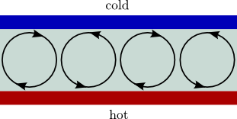
Rayleigh-Benard problem
cold
Hydrodynamic
fluctuations
hot

Slide 7
Constraints
Current formulation of hydrodynamics is
awkward.
Constitutive relations : not enough to just write down the most
general derivative expansion consistent with symmetries.
Phenomenological constraints: solutions should satisfy:
1. Entropy condition
2. Onsager relations: linear response matrix must be symmetric
awkward: use solutions to constrain equations of motion
Clearly something more fundamental is missing
Microscopic origin?
Are these complete?

Slide 8
Will address these issues by developing hydrodynamics as a low energy effective field theory of a general many-body system at finite temperature
Action principle for full fluctuating hydrodynamics applicable to far from equilibrium situations

Slide 9
Closed time path
Standard lore: Dissipative systems don't have an action formulation
This issue is naturally resolved by quantum mechanics.
Interested in describing real-time dynamics around a state, not transition amplitude
Closed time path (CTP) or Schwinger-Keldysh contour
Requires doubling the number of d.o.f.

Slide 10
Effective field theory for fluids
Microscopic description (in thermal density matrix)
hydrodynamic
modes (2 sets)
Hydro EFT:
RG
thermal state reflected in coefficients of action
Standard hydro: saddle point equations
Macroscopic phenomena
1. What are ?
do not work
2. What are the symmetries of ?
3. Integration measure?

Slide 11
Searching for an action principle for dissipative hydrodynamics has been a long standing problem, dating back at least to the ideal fluid action of G. Herglotz in 1911.
Relativistic: Taub, Salmon, Carter, …...
Reviews: Jackiw, Nair, Pi and Polychronakos; Andersson and Comer
The last decade has seen a renewed interest:
Dubovsky, Gregoire, Nicolis and Rattazzi hep-th/0512260
Dubovsky, Hui, Nicolis and Son, arXiv:1107.0731
Including dissipation: Grozdanov and Polonyi; Harder, Kovtun, and Ritz; Kovtun, Moore and Romatschke; Endlich, Nicolis, Porto and J. Wang, …...
Holographic: Nickel, Son; de Boer, Heller, Pinzani-Fokeeva; Crossley, Glorioso., HL, Y. Wang.
An alternative approach: Haehl, Loganayagam and Rangamani, arXiv:1510.02494, 1511.07809

Slide 12
Here for conceptual simplicity, I will describe the story for
neutral normal fluids.
Description for full charged fluids is given in:
Crossley, Glorioso, and HL, arXiv: 1511.03646
Can also be generalized to superfluids (S. Rajagopal and HL, to appear)

Slide 13
Dynamical variables
Recall Lagrange description of hydrodynamics:
: label fluid elements
:
describe fluid motion
An ”integrating-in” procedure to identify gapless and long-lived d.o.f. associated with a conserved stress tensor:
: internal time
Also natural from
Holography:
Nickel, Son,
arXiv:1009.3094

Slide 14
Standard hydro variables (which are now derived quantities)
Noise:
A significant challenge: ensure the eoms from the action
of X can be solely expressed in terms of these velocity.
(e.g. solids v.s. fluids)

Slide 15
Symmetries
label individual fluid elements,
internal time
Require the action to be invariant under:
define what is a fluid!
It turns out these symmetries indeed do magic for you:
at the level of equations of motion, they ensure all dependence on dynamical variables can be expressed in and temperature.
Recover standard formulation of hydrodynamics
(modulo phenomenological constraints)

Slide 16
Full non-linear fluid fluctuating dynamics encoded in non-trivial differential geometry:
This would be the full the story in a usual situation.

Slide 17
Consistency conditions and symmetries
For a system defined with CTP:
constraints on correlation functions,
Require further symmetries satisfied by the off-shell action
so that these constraint conditions are satisfied after doing
the path integral.

Slide 18
Reflectivity and KMS conditions
g₁
=
g₂
Reflectivity condition:
Can be satisfied by imposing a Z₂ reflection symmetry on both
dynamical and background fields
Complex action: non-negativity of imaginary part
KMS conditions plus CPT imply a Z₂ symmetry on W:
characterize thermal state
inverse temperature at spatial infinities
Can be satisfied by imposing a Z₂ symmetry on the action: local KMS conditions

Slide 19
All the constraints from entropy current condition and linear Onsager relations
New constraints on equations of motion from nonlinear
generalizations of Onsager relations.
Non-equilibrium fluctuation-dissipation relations
Crossley, Glorioso, HL
to appear
Local Z₂ KMS condition + equations of motion + non-negativity of
imaginary part of the action
conserved and entropy current
at ideal level

Slide 20
Unitary condition
g₁=g
g₂=g
This may be considered as a condition on path integral measure.
Resolution: Introduce a fermionic partner (“ghost”) for each
dynamical variable and require the action to have a “BRST” type
symmetry :
See also Haehl, Loganayagam and Rangamani arXiv: 1510.02494
To describe hydrodynamical flucatuations properly
anti-commuting objects are needed !
(BRST symmetry here is a global symmetry)

Slide 21
KMS condition and Supersymmetry
Strong indications that BRST + local KMS condition
emergent fermionic symmetry:
Classical limit:
Standard supersymmetry in time direction.
See also Haehl, Loganayagam and Rangamani, arXiv: 1510.02494, 1511.07809
Ping Gao and HL, in progress
Quantum level: indications of a “quantum-deformed” SUSY
algebra

Slide 22
Summary
1. Hydrodynamics with classical statistical fluctuations
is described by a supersymmetric quantum field theory
Recovers the standard hydrodynamics, new constraints, non-equilibrium fluctuation-dissipation relations
Full non-linear fluid fluctuating dynamics encoded in non-trivial differential geometry.
2. Hydrodynamics with quantum fluctuations also incorporated
is described by a “quantum-deformed” (supersymmetric) quantum field theory.

Slide 23
Bosonic action for full charged fluids
A double expansion in terms of noises and derivatives:
All coefficients are functions of

Slide 24
Future directions
Formalism:
Non-relativistic, (to appear with Glorioso)
superfluids, (to appear with S. Rajagopal)
Deeper understanding of KMS, unitarity and supersymmetry (in progress with Ping Gao)
“quantum-deformed” Supersymmetry
…....
Applications:
Transports (longtime tails)
Non-equilibrium steady states, dynamical flows of QGP
Dynamical aspects of phase transitions
Novel fixed points of hydro EFT, such as KPZ scaling, turbulence ….
….........

Slide 25
Thank you!

