Slide 1
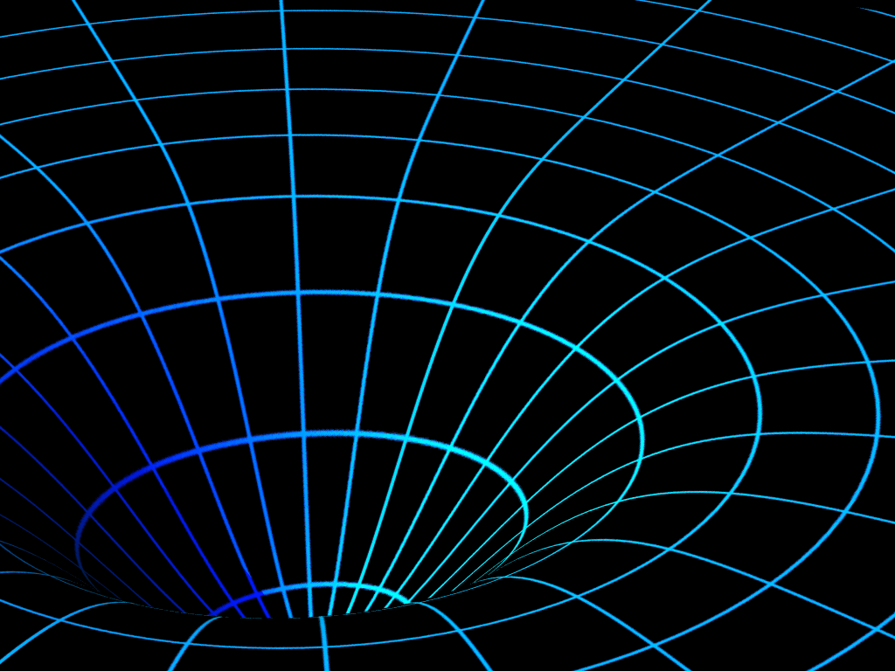
Negative Branes, Supergroups and The Signature of Spacetime
Robbert Dijkgraaf
Institute for Advanced Study Strings 2016, Beijing, Aug 4, 2016
Arxiv: with Ben Heidenreich, Patrick Jefferson & Cumrun Vafa

Slide 2
Controversial Ideas
Supergroup gauge theories
Negative-energy states
Non-unitary theories
Multiple times
Signature change in quantum gravity
Exotic string theories consistent with supersymmetry

Slide 3
Supergroup Gauge Theories
Gauge supergroup
Symmetries of
B, C ghost fields
Large N, M expansion
Perturbatively

Slide 4
Why consider supergroups?
Determination of signature of space-time in string theory.
Emergence of time, dS/CFT duality.
Cosmological holography, away from S-matrix.
Second-quantization of branes.
Full spectrum of extensive objects in M/string theory.
Different non-perturbative completions.
Looking behind the horizon of black holes.

Slide 5
Negative-Brane Realization
Okuda, Takayanagi,
Ghost branes

Slide 6
Positive & Negative BPS Branes
D⁺ branes, charge Q > 0 Tension M = Q > 0
D⁺ antibranes, charge Q < 0 Tension M = - Q > 0
Preserve the same
supersymmetry
algebra
D⁻ branes, charge Q < 0 Tension M = Q < 0

Slide 7
Dirac Sea
Positive branes
energy
Negative branes

Slide 8
Second Quantization
time

Slide 9
Supergroup Gauge Theories
U(N + k|k) Yang-Mills theory
Does it exist non-perturbatively? Different completions of U(N) for different values of k,
Non-unitary: negative energy v. negative norms.

Slide 10
Non-Unitary QFTs
Do exist in 2d, e.g. general (p,q) minimal models
Lee-Yang edge singularity, φ³, critical O(N),… analyzed numerically in dimension d > 2.
In Euclidean space-time turn into oscillating integral
Choose appropriate contour in complex field space: holomorphic blocks?

Slide 11
Exact RG
Arnone, Kubyshin,
Morris, Tighe
Bosonic Yang-Mills with gauge supergroup, plus Higgs fields
Second gauge field A— Pauli-Villars field.
Fermionic gauge field massive after symmetry breaking.
Cut-off high enough A— not excited.
Keeping SU(N) gauge symmetry explicit.

Slide 12
Negative D-branes
Black D-brane geometry in string frame
Harmonic function
Perturbatively g_{s} ~ 0:
Non-perturbatively g_{s} ≠ 0:
naked singularity at H = 0
Flat space-time

Slide 13
Negative D0-branes
M-theory metric in 11 dimensions
pp-wave, smooth at H = 0

Slide 14
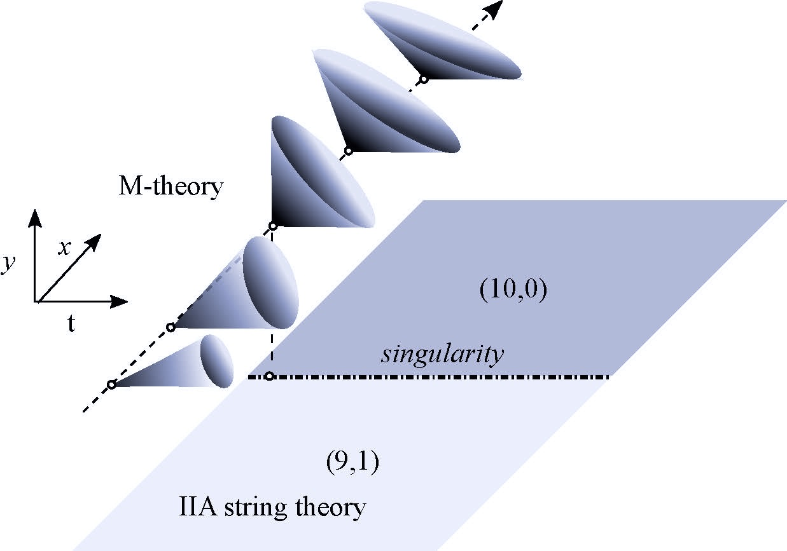
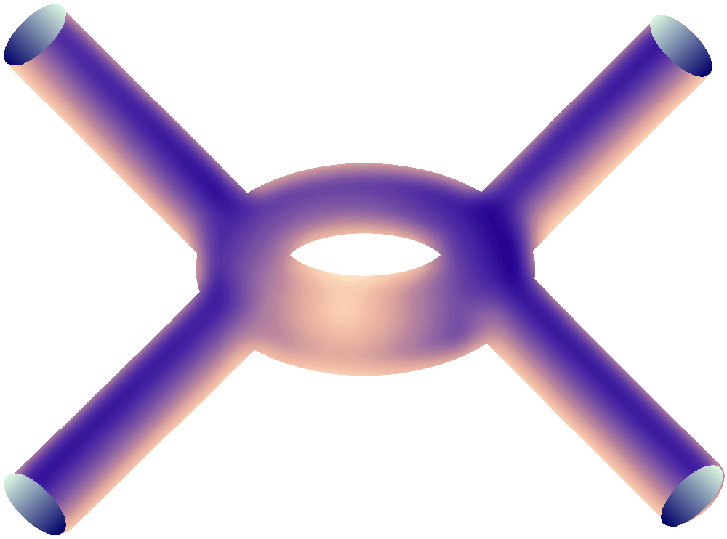
M-theory on time-like circle: closed time-like loops

Slide 15
Analytic Continuation
After absorbing complex factors in
Bubble of space-time with different signature
Supersymmetric probes finite tension

Slide 16
Cauchy Problem
More than one time: ill-posed initial value problem
Spatial momentum space sign(r,s). Non-local constraint
How to extend to interacting theory?
Modular theta-functions for indefinite signatures

Slide 17
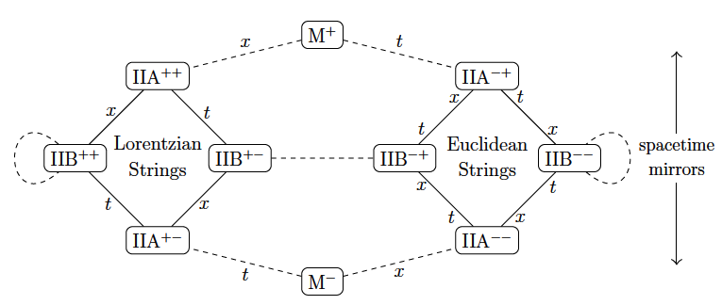
Hull Dualities
Hull, Khuri
T-dualities of Type II string theory on compactified
timelike dimension: exotic string theories.
F-strings, D-branes, NS5-branes will also have different signatures,
Type IIA/B±± F1, D1/2 Lorentzian or Euclidean
M±-theory: M2 Lorentzian or Euclidean

Slide 18
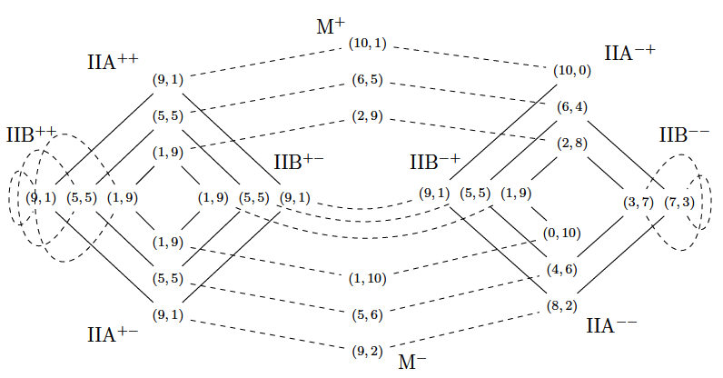
Web of Possible Signatures

Slide 19
Possible Spacetime & Worldvolume Signatures

Slide 20
AdS/CFT
Near-horizon geometry for U(0|N) D3⁻ branes: IIB_{7,3} string theory
Bubble of space-time with different signature
near-horizon

Slide 21
Cosmological Applications
3D gauge theory with one scalar
Bubble of space-time with different signature

Slide 22
N=2 Supergroup Theories
N=2 super Yang-Mills with gauge supergroup
Beta function
Claim: SW curve depends on N + M – 1 parameters, equivalent
to SU(N) + 2M matter fields with pairwise equal masses.
Recall SW-curve

Slide 23
N=2 Supergroup Theories
Claim: SW-curve for supergroup
SU(N) with 2M matter fields

Slide 24
Exercise: Higgsing

Slide 25
Negative Branes

Slide 26
Geometric Engineering
Multicenter Taub-NUT space for D3 branes
Complex structure A_{N-1} singularity
Generalizes to

Slide 27
Nekrasov Instanton Calculation
Start with
Couplings
Limit of exact SW curve

Slide 28
Super Matrix Models
Supergroup
Volume Lie supergroup vanishes: need regularization
Diagonalize: eigenvalues & anti-eigenvalues

Slide 29
Bosonic Matrix Model
’t Hooft limit
Filling fractions (perturbative expansion)

Slide 30
Eigenvalue Dynamics
Effective action (repulsive Coulomb force)

Slide 31
Resolvent
+
+
+
+
+
+
+
+
+
eigenvalues
+
probe

Slide 32
Resolvent
branch cut
+
probe

Slide 33
Effective Geometry
+
probe
second
sheet

Slide 34
Effective Geometry
+
probe
Are both sheets visible?

Slide 35
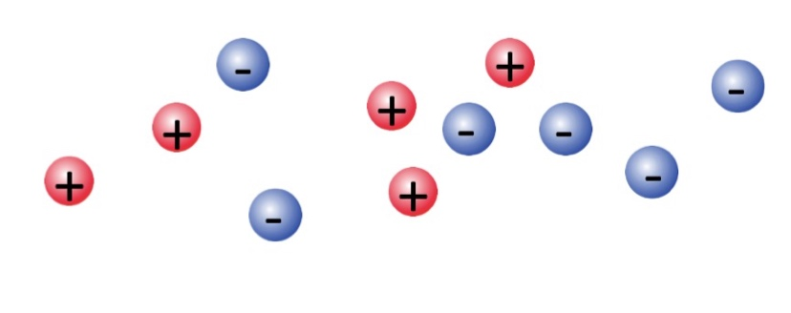
Super Jacobian
Eigenvalues of charge +1 and -1 (Coulomb gas model)
Resolvent
Same periods as U(N-M) model

Slide 36
Non-Perturbative Corrections
[Vafa] U(N|M) has more Casimirs than U(N), e.g.
General deformation
For example, for U(2|1)

Slide 37
Non-Perturbative Corrections
So correlators are sensitive to k.
General pattern: calculation of partition function
and correlation functions for U(N + k|k) depend
non-perturbatively (order e^{-N} ) on k.
Working with supermatrix models seems to probe
the full effective geometry.

Slide 38
Topological D-Branes
Open string partition function

Slide 39
Quantum Wave Function
Single brane wave function
Quantization of phase space

Slide 40
Gaussian Matrix Model
Eigenfunctions of harmonic oscillator

Slide 41
Negative Branes
Non-normalizable eigenfunctions of harmonic oscillator
WKB behavior
Probe other sheet

Slide 42
Conclusion
Unification of crazy ideas
Need more crazy ideas!
Supergroup gauge theories
Non-unitary QFT Negative tension branes
Spacetime signature change
Closed timelike loops

